Slide 1

From Nand to Tetris
Building a Modern Computer from First Principles
Chapter 4
Machine Language
These slides support chapter 4 of the book
The Elements of Computing Systems
(1st and 2nd editions)
By Noam Nisan and Shimon Schocken
MIT Press

Slide 2
Usage Notice
You are welcome to use this presentation, or any part of it, in Nand to Tetris courses, or in other courses, as you see fit.
Usage is free provided that it supports instruction in educational, non-profit settings.
You can use the slides as-is, or modify them as needed.
We’ll appreciate it if you will credit Nand to Tetris somewhere, and put a reference to www.nand2tetris.org
Happy teaching!
Shimon Schocken / Noam Nisan

Slide 3
Nand to Tetris Roadmap (Part I: Hardware)
abstraction
machine language
Developing an assembler
hardware platform
abstraction
Building a computer
computer
abstraction
Building chips
ALU, RAM
abstraction
Building gates
p2
elementary logic gates
Nand
p3
p1
In previous chapters we’ve built the computer’s ALU and RAM

Slide 4
Nand to Tetris Roadmap (Part I: Hardware)
abstraction
In this chapter we’ll become familiar with:
The Hack computer / instruction set
Low-level programming
Assembly / assemblers
p4
Writing low-level programs
machine language
Developing an assembler
hardware platform
abstraction
Building a computer
computer
abstraction
Building chips
ALU, RAM
abstraction
Building gates
p2
elementary logic gates
Nand
p3
p1
In previous chapters we’ve built the computer’s ALU and RAM

Slide 5

Computers are flexible and versatile
Same hardware can run many different programs (software)

Slide 6
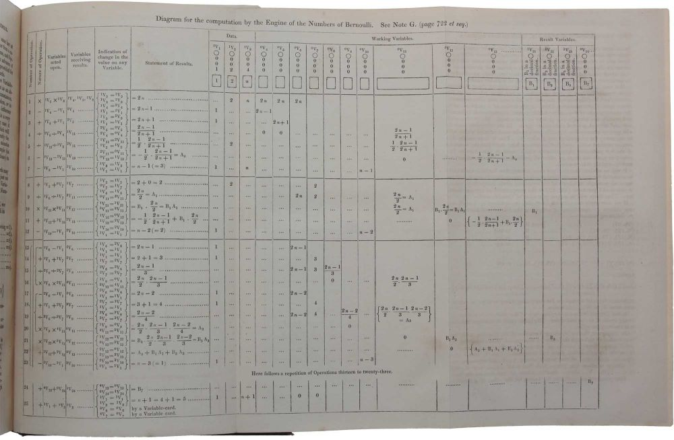
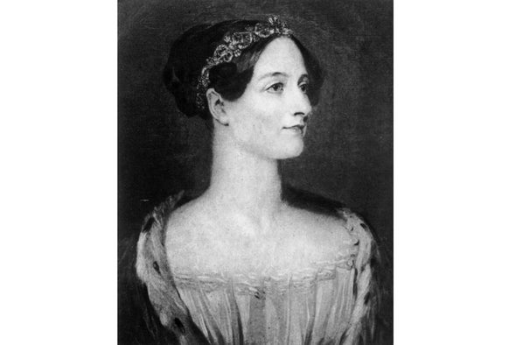

Computers are flexible and versatile
Same hardware can run many different programs (software)
Ada Lovelace
(1843)
Early symbolic program
Landmark “proof of concept” that computers can be programmed

Slide 7
Computers are flexible and versatile
Same hardware can run many different programs (software)
Alan Turing
(1936)
Universal Turing Machine
Landmark article, describing a theoretical general-purpose computer

Slide 8
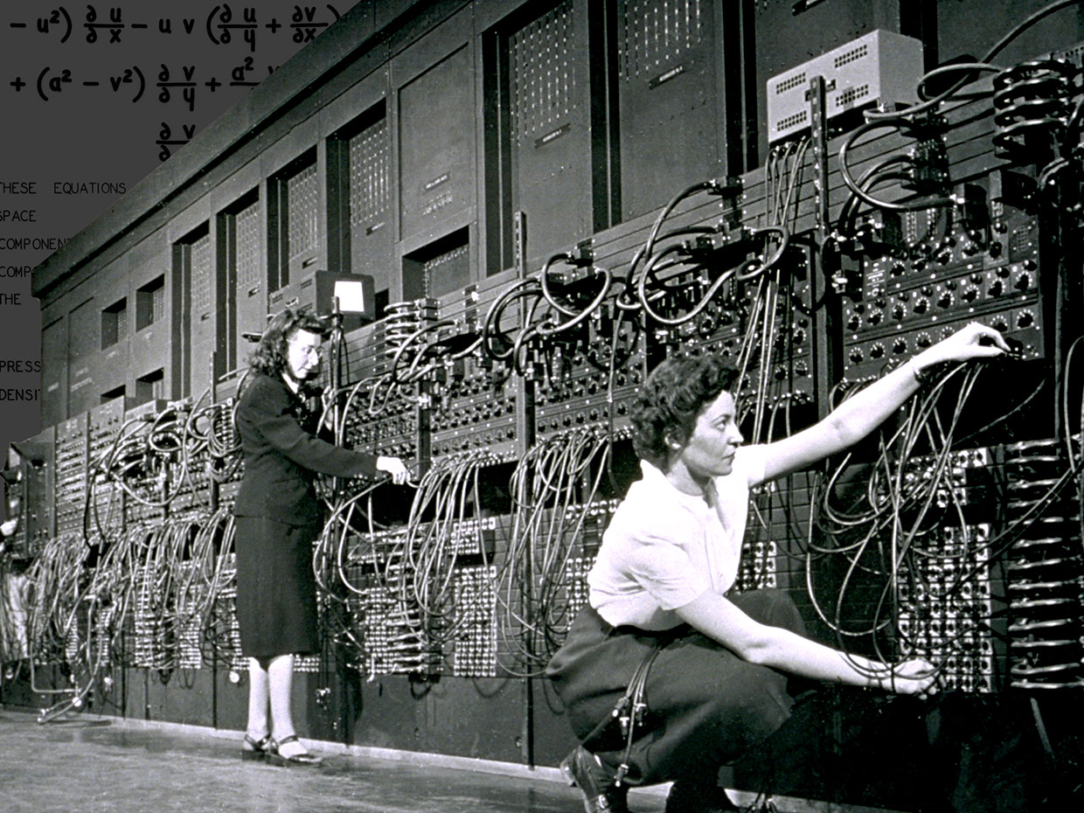
Computers are flexible and versatile
Same hardware can run many different programs (software)
First general-purpose computer
Eniac, University of Pennsylvania, 1945

Slide 9
Computer architecture
Memory
CPU
input
ALU
output
registers

Slide 10
Computer architecture
Memory
CPU
program
input
ALU
output
data
registers

Slide 11
Computer architecture
Memory
CPU
0
1
2
...
0101110011100110
1100000010010001
1110001011111100
...
instructions
input
ALU
output
1100101010010101
1100100101100111
0011001010101011
...
data
registers

Slide 12
Computer architecture
Memory
CPU
0
1
2
...
0101110011100110
1100000010010001
1110001011111100
...
instruction
instructions
input
ALU
output
1100101010010101
1100100101100111
0011001010101011
...
data
registers

Slide 13
Computer architecture
Memory
CPU
0
1
2
...
0101110011100110
1100000010010001
1110001011111100
...
instruction
instructions
input
ALU
output
1100101010010101
1100100101100111
0011001010101011
...
Data value
data
registers
Stored program concept
The computer memory can store programs, just like it stores data
Programs = data.
One of the most important ideas in the history of computer science

Slide 14
Chapter 4: Machine Language
Overview
Machine languages
The Hack computer
The Hack instruction set
The Hack CPU Emulator
Symbolic programming
Control
Variables
Labels
Low Level Programming
Basic
Iteration
Pointers
The Hack Language
Usage
Specification
Output
Input
Project 4

Slide 15
Machine Language
Memory
CPU
Computer
(Conceptual definition):
A processor (CPU) that manipulates a set of registers:
CPU-resident registers (few, accessed directly, by name)
Memory-resident registers (many, accessed by supplying an address)
0
12
1
615
2
8828
3
3
ALU
...
-5
Registers
136
955
R1
10
137
20
R2
5
138
-523
•
•
...
•
A
137
Machine language
A formalism specifying how to access and manipulate registers.

Slide 16
Registers
Data registers:
Hold data values
Memory
CPU
0
12
1
615
2
8828
3
3
ALU
Address register:
Holds an address
...
-5
Registers
Instruction register:
Holds an instruction
R1
10
136
955
137
20
R2
5
138
-523
•
•
...
•
A
137
All these registers are… registers (containers that hold bits)
The number and bit-width of the registers vary greatly from one computer to another.

Slide 17
Typical operations
// R1 ← 73
load R1, 73
// R1 ← R1 + R2
add R1, R2
Memory
CPU
0
12
1
615
2
8828
3
3
ALU
...
-5
Registers
136
955
R1
10
137
20
R2
5
138
-523
•
•
...
•
A
137

Slide 18
Typical operations
// R1 ← 73
load R1, 73
// R1 ← R1 + R2
add R1, R2
// R1 ← R1 + Memory[137]
add R1, M[137]
// R1 ← Memory[A]
load R1, @A
Memory
CPU
0
12
1
615
2
8828
3
3
ALU
...
-5
Registers
136
955
R1
10
137
20
R2
5
138
-523
•
•
...
•
A
137
The syntax of machine languages varies greatly from one computer to another, but all of them are designed to do the same thing: Manipulate registers.

Slide 19
Control
Memory
CPU
0
1110111100001010
1
1100000011111110
2
0110111100001010
3
1100000011111110
ALU
...
0101100011100110
Registers
136
0001100011011100
R1
000000000010010
137
1100000011111110
R2
0000000000000101
138
0101110010001110
•
•
...
•
A
00000010110000

Slide 20
Control
Memory
CPU
Which instruction should be executed next?
By default, the CPU executes the next instruction
Sometimes we want to “jump” to execute another instruction
0
1110111100001010
1
1100000011111110
current instruction
2
0110111100001010
3
1100000011111110
ALU
...
0101100011100110
Registers
136
0001100011011100
R1
000000000010010
137
1100000011111110
R2
0000000000000101
138
0101110010001110
•
•
...
•
A
00000010110000

Slide 21
Control
Unconditional branching
Execute some instruction other than the next one
Example: Embarking on a new iteration in a loop
Basic version
...
// Adds 1 to R1, repetitively

Slide 22
Control
Unconditional branching
Execute some instruction other than the next one
Example: Embarking on a new iteration in a loop
Basic version
Symbolic version
...
// Adds 1 to R1, repetitively
add R1,1
...
goto 13
...
...
// Adds 1 to R1, repetitively
(LOOP)
add R1,1
...
goto LOOP
...
13
...
27
...
Line numbers
Physical addresses
No line numbers
Symbolic addresses
Programs with symbolic references are …
Easier to develop
Readable
Relocatable.

Slide 23
Control
Conditional branching
Sometimes we want to “jump” to execute another instruction, but only if a certain condition is met
Symbolic program
// Set R1 to abs(R1).

Slide 24
Control
Conditional branching
Sometimes we want to “jump” to execute another instruction, but only if a certain condition is met
Symbolic program
// Set R1 to abs(R1).
// if R1 > 0 goto CONT
jgt R1,CONT
CONT:
// Here R1 is non-negative
...
conditional goto

Slide 25
Control
Conditional branching
Sometimes we want to “jump” to execute another instruction, but only if a certain condition is met
Symbolic program
// Set R1 to abs(R1).
// if R1 > 0 goto CONT
jgt R1,CONT
// R1 ← –R1
store R2,R1
store R1,0
subt R1,R2
CONT:
// Here R1 is non-negative
...
How can we actually execute the program?

Slide 26
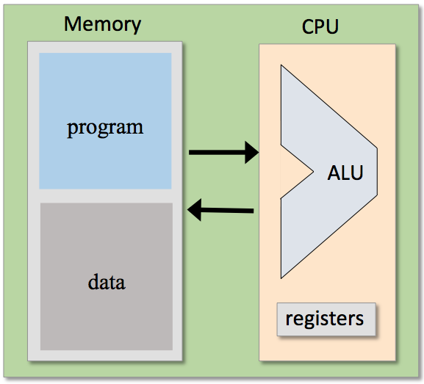
Control
Conditional branching
Sometimes we want to “jump” to execute another instruction, but only if a certain condition is met
Symbolic program
Binary code
// Set R1 to abs(R1).
// if R1 > 0 goto CONT
jgt R1,CONT
// R1 ← –R1
store R2,R1
store R1,0
subt R1,R2
CONT:
// Here R1 is non-negative
...
0101111100111100
1010101010101010
1100000010101010
1011000010000001
...
translate
load and execute
Assembly
Assembler

Slide 27

Chapter 4: Machine Language
Overview
Machine languages
The Hack computer
The Hack instruction set
The Hack CPU Emulator
Symbolic programming
Control
Variables
Labels
Low Level Programming
Basic
Iteration
Pointers
The Hack Language
Usage
Specification
Output
Input
Project 4

Slide 28
The Hack computer
Data memory
Instruction memory
0
1
2
...
0000110011100111
0
1
2
...
0010101010110110
1000110000110000
1111100100101011
0000010011111100
0011101001011011
RAM
ROM
address
out
address
out
(Conceptual, partial view of the Hack computer architecture)
0000011100110010
1110011001011001
Address register
Data register
A
0001101001101111
D
1001000011110101
Hack is a 16-bit computer, featuring two memory units
The address input of each memory unit is 15-bit wide
Question: How many words can each memory unit have?
Answer: The address space of each memory unit is 2¹⁵ = 32K words.

Slide 29
Memory
Data memory
Instruction memory
0
1
2
...
0000110011100111
0
1
2
...
0010101010110110
1000110000110000
1111100100101011
0000010011111100
0011101001011011
RAM
ROM
address
out
address
out
(Conceptual, partial view of the Hack computer architecture)
...
32766
32767
...
32766
32767
0000011100110010
1110011001011001
Address register
Data register
A
0001101001101111
D
1001000011110101
RAM
Read-write data memory
Addressed by the A register

Slide 30
Memory
Data memory
Instruction memory
0
1
2
...
0000110011100111
0
1
2
...
0010101010110110
1000110000110000
1111100100101011
0000010011111100
0011101001011011
RAM
ROM
address
out
address
out
(Conceptual, partial view of the Hack computer architecture)
...
32766
32767
0000111100110010
...
32766
32767
M
0000011100110010
1110011001011001
Address register
Data register
A
0001101001101111
D
1001000011110101
RAM
Read-write data memory
Addressed by the A register
The selected register, RAM[A], is represented by the symbol M

Slide 31
Memory
Data memory
Instruction memory
Loaded with a sequence of 16-bit Hack instructions
0
1
2
...
0000110011100111
0
1
2
...
0010101010110110
1000110000110000
1111100100101011
0000010011111100
0011101001011011
RAM
ROM
address
out
address
out
(Conceptual, partial view of the Hack computer architecture)
...
32766
32767
0000111100110010
...
32766
32767
M
0000011100110010
1110011001011001
Address register
Data register
A
0001101001101111
D
1001000011110101
RAM
Read-write data memory
Addressed by the A register
The selected register, RAM[A], is represented by the symbol M
ROM
Read-only instruction memory

Slide 32
Memory
Data memory
Instruction memory
Loaded with a sequence of 16-bit Hack instructions
0
1
2
...
0000110011100111
0
1
2
...
0010101010110110
1000110000110000
1111100100101011
0000010011111100
0011101001011011
RAM
ROM
address
out
address
out
(Conceptual, partial view of the Hack computer architecture)
...
32766
32767
0000111100110010
...
32766
32767
1001111100011001
M
0000011100110010
1110011001011001
Address register
Data register
A
0001101001101111
D
1001000011110101
RAM
Read-write data memory
Addressed by the A register
The selected register, RAM[A], is represented by the symbol M
ROM
Read-only instruction memory
Addressed by the (same) A register
The selected register, ROM[A], contains the “current instruction”

Slide 33
Memory
Data memory
Instruction memory
Loaded with a sequence of 16-bit Hack instructions
0
1
2
...
0000110011100111
0
1
2
...
0010101010110110
1000110000110000
1111100100101011
0000010011111100
0011101001011011
RAM
ROM
address
out
address
out
(Conceptual, partial view of the Hack computer architecture)
...
32766
32767
0000111100110010
...
32766
32767
1001111100011001
M
0000011100110010
1110011001011001
Address register
Data register
A
0001101001101111
D
1001000011110101
RAM
Read-write data memory
Addressed by the A register
The selected register, RAM[A], is represented by the symbol M
ROM
Read-only instruction memory
Addressed by the (same) A register
The selected register, ROM[A], contains the “current instruction”
Should we focus on RAM[A], or on ROM[A]?
Depends on the current instruction (later)

Slide 34
Registers
Data memory
Instruction memory
0
1
2
...
0
1
2
...
RAM
ROM
address
M
out
address
instruction
out
(Conceptual, partial view of the Hack computer architecture)
...
32766
32767
...
32766
32767
Address register
Data register
A
D
D: data register
A: address register
M: the selected RAM register

Slide 35
Chapter 4: Machine Language
Overview
Machine languages
The Hack computer
The Hack instruction set
The Hack CPU Emulator
Symbolic programming
Control
Variables
Labels
Low Level Programming
Basic
Iteration
Pointers
The Hack Language
Usage
Specification
Output
Input
Project 4

Slide 36
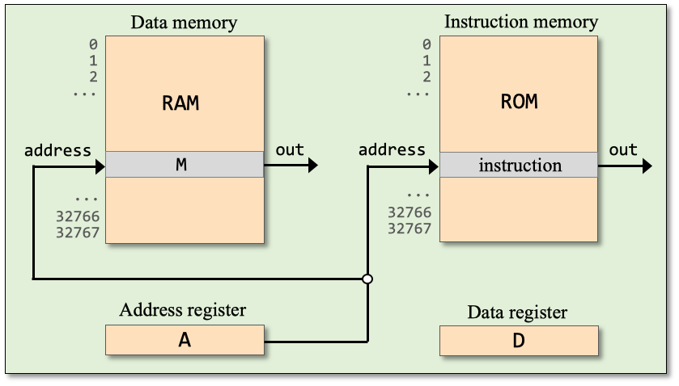
Hack instructions
Instruction set
A instruction
C instruction

Slide 37
Hack instructions
Instruction set
A instruction
C instruction
Syntax:
Example:
Semantics:
@ const
@ 19
A ← 19
where const is a constant
Side effects:
RAM[A] (called M) becomes selected
ROM[A] becomes selected
(Complete / formal syntax, later).

Slide 38
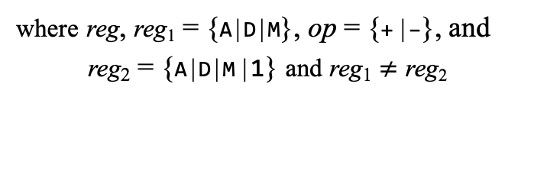
Hack instructions
Instruction set
A instruction
C instruction
Syntax:
reg = {0 | 1 | –1}
reg₁ = reg₂
reg = reg₁ op reg₂
where reg = {A | D | M}
where reg₁ = {A | D | M}
reg₂ = [–] {A | D | M}
where reg, reg₁ = {A | D | M}, op = {+ | –}, and
reg₂ = {A | D | M | 1} and reg₁ $≠$ reg₂
Examples:
D=0
A=–1
M=1
...
D=A
D=M
M=–M
...
D=D+M
A=A–1
M=D+1
...
(Complete / formal syntax, later).

Slide 39
Hack instructions
Typical instructions:
@ constant
(A ← constant)
D=1
D=A
D=D+1
...
D=D+A
D=M
M=0
...
M=D
D=D+A
M=M–D
...
Examples:
// D ← 2
The game: We show some typical Hack instructions (top left), and practice writing code examples that use subsets of these instructions.
?

Slide 40
Hack instructions
Typical instructions:
@ constant
(A ← constant)
D=1
D=A
D=D+1
...
D=D+A
D=M
M=0
...
M=D
D=D+A
M=M–D
...
Examples:
// D ← 2
D=1
D=D+1
// D ← 1954
?
Use only the instructions shown in this slide

Slide 41
Hack instructions
Typical instructions:
@ constant
(A ← constant)
D=1
D=A
D=D+1
...
D=D+A
D=M
M=0
...
M=D
D=D+A
M=M–D
...
Examples:
// D ← 2
D=1
D=D+1
// D ← 1954
@1954
D=A
// D ← D + 23
?
Use only the instructions shown in thus slide

Slide 42
Hack instructions
Typical instructions:
@ constant
(A ← constant)
D=1
D=A
D=D+1
...
D=D+A
D=M
M=0
...
M=D
D=D+A
M=M–D
...
Examples:
// D ← 2
D=1
D=D+1
// D ← 1954
@1954
D=A
// D ← D + 23
@23
D=D+A
Observation
In these examples we use the address register A as a data register:
The addressing side-effects of A are ignored.

Slide 43
Hack instructions
Typical instructions:
@ constant
(A ← constant)
D=1
D=A
D=D+1
...
D=D+A
D=M
M=0
...
M=D
D=D+A
M=M–D
...
More examples:
// RAM[100] ← 0

Slide 44
Hack instructions
Typical instructions:
@ constant
(A ← constant)
D=1
D=A
D=D+1
...
D=D+A
D=M
M=0
...
M=D
D=D+A
M=M–D
...
More examples:
// RAM[100] ← 0
@100
M=0
// RAM[100] ← 17

Slide 45
Hack instructions
Typical instructions:
@ constant
(A ← constant)
D=1
D=A
D=D+1
...
D=D+A
D=M
M=0
...
M=D
D=D+A
M=M–D
...
More examples:
// RAM[100] ← 0
@100
M=0
// RAM[100] ← 17
@17
D=A
@100
M=D
First pair of instructions: A is used as a data register
Second pair of instructions: A is used as an address register

Slide 46
Hack instructions
Typical instructions:
@ constant
(A ← constant)
D=1
D=A
D=D+1
...
D=D+A
D=M
M=0
...
M=D
D=D+A
M=M–D
...
More examples:
// RAM[100] ← 0
@100
M=0
// RAM[100] ← 17
@17
D=A
@100
M=D
// RAM[100] ← RAM[200]
?

Slide 47
Hack instructions
Typical instructions:
@ constant
(A ← constant)
D=1
D=A
D=D+1
...
D=D+A
D=M
M=0
...
M=D
D=D+A
M=M–D
...
More examples:
// RAM[100] ← 0
@100
M=0
// RAM[100] ← 17
@17
D=A
@100
M=D
// RAM[100] ← RAM[200]
@200
D=M
@100
M=D
When we want to operate on a memory register, we typically need a pair of instructions:
A instruction: Selects a memory register
C instruction: Operates on the selected register.

Slide 48
Hack instructions
Typical instructions:
@ constant
(A ← constant)
D=1
D=A
D=D+1
...
D=D+A
D=M
M=0
...
M=D
D=D+A
M=M–D
...
// RAM[3] ← RAM[3] – 15
?
Use only the instructions shown in the current slide

Slide 49
Hack instructions
Typical instructions:
@ constant
(A ← constant)
D=1
D=A
D=D+1
...
D=D+A
D=M
M=0
...
M=D
D=D+A
M=M–D
...
// RAM[3] ← RAM[3] – 15
@15
D=A
@3
M=M–D
// RAM[3] ← RAM[4] + 1
Use only the instructions shown in the current slide
?

Slide 50
Hack instructions
Typical instructions:
@ constant
(A ← constant)
D=1
D=A
D=D+1
...
D=D+A
D=M
M=0
...
M=D
D=D+A
M=M–D
...
// RAM[3] ← RAM[3] – 15
@15
D=A
@3
M=M–D
// RAM[3] ← RAM[4] + 1
@4
D=M+1
@3
M=D
Use only the instructions shown in the current slide

Slide 51
Hack instructions
Typical instructions:
@ constant
(A ← constant)
A=1
D=–1
M=0
...
A=M
D=M
M=D
...
A=D-A
D=D+A
D=D+M
...
Add.asm
// Computes: RAM[2] = RAM[0] + RAM[1] + 17
?
Use only the instructions shown in the current slide

Slide 52
Hack instructions
Typical instructions:
@ constant
(A ← constant)
A=1
D=–1
M=0
...
A=M
D=M
M=D
...
A=D-A
D=D+A
D=D+M
...
Add.asm
// Computes: RAM[2] = RAM[0] + RAM[1] + 17
// D = RAM[0]
@0
D=M
// D = D + RAM[1]
@1
D=D+M
// D = D + 17
@17
D=D+A
// RAM[2] = D
@2
M=D

Slide 53
Hack instructions
Typical instructions:
(A ← constant)
@ constant
(A ← constant)
@ constant
A=1
D=–1
M=0
...
A=M
D=M
M=D
...
A=D-A
D=D+A
D=D+M
...
Add.asm
// Computes: RAM[2] = RAM[0] + RAM[1] + 17
// D = RAM[0]
@0
D=M
// D = D + RAM[1]
@1
D=D+M
// D = D + 17
@17
D=D+A
// RAM[2] = D
@2
M=D
How can we tell that a given program actually works?
Testing / simulating
Formal verification

Slide 54
Chapter 4: Machine Language
Overview
Machine languages
The Hack computer
The Hack instruction set
The Hack CPU Emulator
Symbolic programming
Control
Variables
Labels
Low Level Programming
Basic
Iteration
Pointers
The Hack Language
Usage
Specification
Output
Input
Project 4

Slide 55
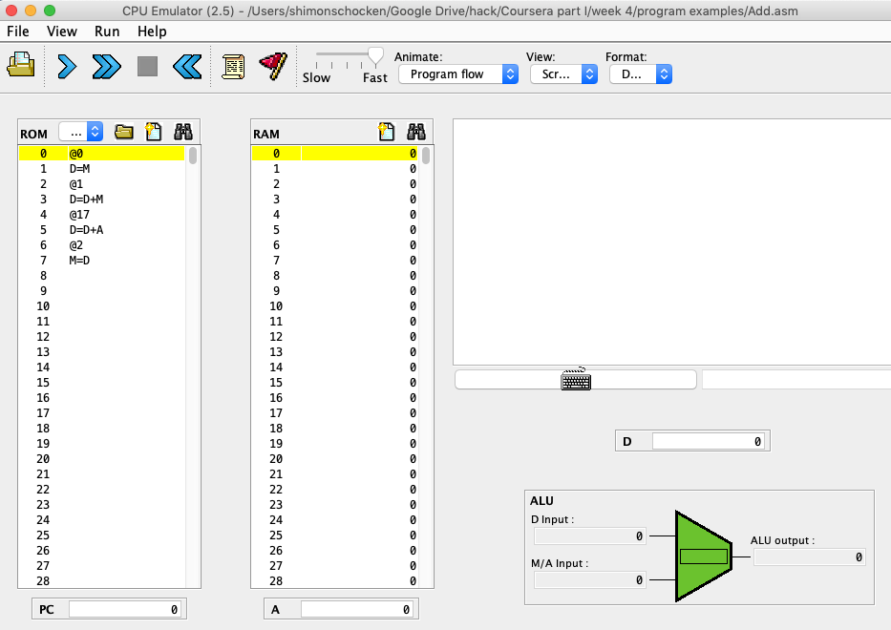
The CPU emulator
execute
The CPU emulator is a Java program, designed to emulate the Hack CPU
On your PC (nand2tetris/tools)
code

Slide 56
The CPU emulator
Add.asm (example)
Binary
// Computes: RAM[2] = RAM[0] + RAM[1] + 17
// D = RAM[0]
@0
D=M
// D = D + RAM[1]
@1
D=D+M
// D = D + 17
@17
D=D+A
// RAM[2] = D
@2
M=D
0000000000000000
1000010010001101
0000000000000001
1010011001100001
0000000000010001
1001111100110011
0000000000000010
1110010010010011
Load into the CPU emulator
Execute
When loading a symbolic program into the CPU emulator, the emulator translates it into binary code (using a built-in assembler)

Slide 57

The CPU emulator
CPU emulator
demo

Slide 58
Chapter 4: Machine Language
Overview
Machine languages
The Hack computer
The Hack instruction set
The Hack CPU Emulator
Symbolic programming
Control
Variables
Labels
Low Level Programming
Basic
Iteration
Pointers
The Hack Language
Usage
Specification
Output
Input
Project 4

Slide 59
Loading a program
Data memory
Instruction memory
Hack program
0
1
2
...
0
1
2
...
instruction
instruction
instruction
instruction
instruction
instruction
instruction
instruction
instruction
RAM
load
ROM
M
Address register
Data register
A
D

Slide 60
Loading a program
Data memory
Instruction memory
Hack program
0
1
2
...
0
1
2
...
instruction
instruction
instruction
instruction
instruction
instruction
instruction
instruction
instruction
instruction
RAM
instruction
load
instruction
instruction
instruction
M
instruction
instruction
instruction
Convention:
The first instruction is loaded into address 0, the next instruction into address 1, and so on.
Address register
Data register
A
D

Slide 61
Executing a program
Data memory
Instruction memory
0
1
2
...
0
1
2
...
instruction
RAM
instruction
instruction
instruction
instruction
M
instruction
instruction
instruction
Address register
Data register
A
D

Slide 62
Executing a program
Data memory
Instruction memory
0
1
2
...
0
1
2
...
instruction
RAM
instruction
instruction
instruction
instruction
M
instruction
instruction
instruction
Address register
Data register
A
D

Slide 63
Executing a program
Data memory
Instruction memory
0
1
2
...
0
1
2
...
instruction
RAM
instruction
instruction
instruction
instruction
M
instruction
instruction
instruction
Address register
Data register
A
D

Slide 64
Executing a program
Data memory
Instruction memory
0
1
2
...
0
1
2
...
instruction
RAM
instruction
instruction
instruction
instruction
M
instruction
instruction
instruction
Address register
Data register
A
D

Slide 65
Executing a program
Data memory
Instruction memory
0
1
2
...
0
1
2
...
instruction
RAM
instruction
instruction
instruction
instruction
M
instruction
instruction
instruction
Address register
Data register
A
D

Slide 66
Executing a program
Data memory
Instruction memory
0
1
2
...
0
1
2
...
instruction
RAM
instruction
instruction
instruction
instruction
M
instruction
instruction
instruction
Address register
Data register
A
D
The default: Execute the next instruction
Suppose we wish to execute another instruction
How to specify this branching?

Slide 67
Branching
Unconditional branching example (pseudocode)
0
1
2
3
4
5
6
7
8
9
10
11
instruction
instruction
instruction
instruction
goto 7
instruction
instruction
instruction
instruction
goto 2
instruction
...
Flow of control:
0,1,2,3,4,
7,8,9,
2,3,4,
7,8,9,
2,3,4,
...

Slide 68
Branching
Conditional branching
example (pseudocode)
0
1
2
3
4
5
6
7
8
9
...
instruction
instruction
instruction
instruction
if (condition) goto 7
instruction
instruction
instruction
instruction
instruction
...
Flow of control:
0,1,2,3,4,
if condition is true
7,8,9,...
else
5,6,7,8,9,...

Slide 69
Branching
Branching in the Hack language:
Example (Pseudocode):
In Hack:
0
1
2
3
4
5
6
7
...
instruction
instruction
goto 6
instruction
instruction
instruction
instruction
instruction
...
…
// goto 6
@6
0;JMP
…
Semantics of 0;JMP
Jump to the instruction stored in the register selected by A
(the “0;” prefix will be explained later)

Slide 70
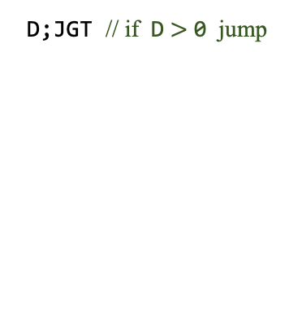
Branching
Branching in the Hack language:
Example (Pseudocode):
In Hack:
Typical branching instructions:
0
1
2
3
4
5
6
7
...
instruction
instruction
if (D > 0) goto 6
instruction
instruction
instruction
instruction
instruction
...
…
// if (D > 0) goto 6
@6
D;JGT
…
D;JGT // if D $>$ 0 jump
to the instruction stored in
ROM[A]

Slide 71
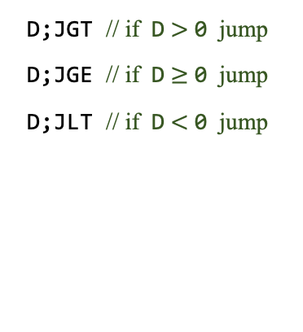
Branching
Branching in the Hack language:
Example (Pseudocode):
In Hack:
Typical branching instructions:
0
1
2
3
4
5
6
7
...
D;JGT // if D $>$ 0 jump
D;JGE // if D $≥$ 0 jump
D;JLT // if D $<$ 0 jump
0
1
2
3
4
5
6
7
...
instruction
instruction
if (D > 0) goto 6
instruction
instruction
instruction
instruction
instruction
...
…
// if (D > 0) goto 6
@6
D;JGT
…
to the instruction stored in
ROM[A]

Slide 72
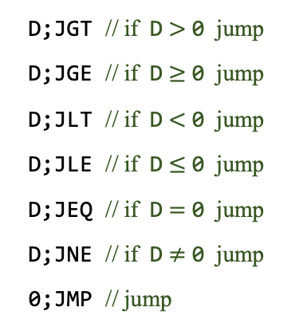
Branching
Branching in the Hack language:
Example (Pseudocode):
In Hack:
Typical branching instructions:
0
1
2
3
4
5
6
7
...
instruction
instruction
if (D > 0) goto 6
instruction
instruction
instruction
instruction
instruction
...
…
// if (D > 0) goto 6
@6
D;JGT
…
D;JGT // if D $>$ 0 jump
D;JGE // if D $≥$ 0 jump
D;JLT // if D $<$ 0 jump
D;JLE // if D $≤$ 0 jump
D;JEQ // if D $=$ 0 jump
D;JNE // if D $≠$ 0 jump
0;JMP // jump
to the instruction stored in
ROM[A]

Slide 73
Branching
Typical instructions:
@ constant
(A ← constant)
A=1
D=-1
M=0
...
A=M
D=A
M=D
...
D=D-A
A=A-1
M=D+1
...
Typical branching instructions:
// if )D = 0( goto 300
D;JGT // if D $>$ 0 jump
D;JGE // if D $≥$ 0 jump
D;JLT // if D $<$ 0 jump
D;JLE // if D $≤$ 0 jump
D;JEQ // if D $=$ 0 jump
D;JNE // if D $≠$ 0 jump
0;JMP // jump
?
to the instruction stored in
ROM[A]
Use only the instructions shown in the current slide

Slide 74
Branching
Typical instructions:
@ constant
(A ← constant)
A=1
D=-1
M=0
...
A=M
D=A
M=D
...
D=D-A
A=A-1
M=D+1
...
Typical branching instructions:
// if )D = 0( goto 300
D;JGT // if D $>$ 0 jump
D;JGE // if D $≥$ 0 jump
D;JLT // if D $<$ 0 jump
D;JLE // if D $≤$ 0 jump
D;JEQ // if D $=$ 0 jump
D;JNE // if D $≠$ 0 jump
0;JMP // jump
to the instruction stored in
ROM[A]
Use only the instructions shown in the current slide

Slide 75
Branching
Typical instructions:
@ constant
(A ← constant)
A=1
D=-1
M=0
...
A=M
D=A
M=D
...
D=D-A
A=A-1
M=D+1
...
Typical branching instructions:
// if )D = 0( goto 300
@300
D;JEQ
D;JGT // if D $>$ 0 jump
D;JGE // if D $≥$ 0 jump
D;JLT // if D $<$ 0 jump
D;JLE // if D $≤$ 0 jump
D;JEQ // if D $=$ 0 jump
D;JNE // if D $≠$ 0 jump
0;JMP // jump
to the instruction stored in
ROM[A]
Use only the instructions shown in the current slide

Slide 76
Branching
Typical instructions:
@ constant
(A ← constant)
A=1
D=-1
M=0
...
A=M
D=A
M=D
...
D=D-A
A=A-1
M=D+1
...
Typical branching instructions:
D;JGT // if D $>$ 0 jump
D;JGE // if D $≥$ 0 jump
D;JLT // if D $<$ 0 jump
D;JLE // if D $≤$ 0 jump
D;JEQ // if D $=$ 0 jump
D;JNE // if D $≠$ 0 jump
0;JMP // jump
to the instruction stored in
ROM[A]

Slide 77
Branching
Typical instructions:
@ constant
(A ← constant)
A=1
D=-1
M=0
...
A=M
D=A
M=D
...
D=D-A
A=A-1
M=D+1
...
Typical branching instructions:
// if (RAM[3] < 100) goto 12
D;JGT // if D $>$ 0 jump
D;JGE // if D $≥$ 0 jump
D;JLT // if D $<$ 0 jump
D;JLE // if D $≤$ 0 jump
D;JEQ // if D $=$ 0 jump
D;JNE // if D $≠$ 0 jump
0;JMP // jump
?
to the instruction stored in
ROM[A]
Use only the instructions shown in the current slide

Slide 78
Branching
Typical instructions:
@ constant
(A ← constant)
A=1
D=-1
M=0
...
A=M
D=A
M=D
...
D=D-A
A=A-1
M=D+1
...
Typical branching instructions:
// if (RAM[3] < 100) goto 12
D;JGT // if D $>$ 0 jump
D;JGE // if D $≥$ 0 jump
D;JLT // if D $<$ 0 jump
D;JLE // if D $≤$ 0 jump
D;JEQ // if D $=$ 0 jump
D;JNE // if D $≠$ 0 jump
0;JMP // jump
to the instruction stored in
ROM[A]
Use only the instructions shown in the current slide

Slide 79
Branching
Typical instructions:
@ constant
(A ← constant)
A=1
D=-1
M=0
...
A=M
D=A
M=D
...
D=D-A
A=A-1
M=D+1
...
Typical branching instructions:
// if (RAM[3] < 100) goto 12
// D = RAM[3] – 100
@3
D=M
@100
D=D–A
// if (D < 0) goto 12
@12
D;JLT
D;JGT // if D $>$ 0 jump
D;JGE // if D $≥$ 0 jump
D;JLT // if D $<$ 0 jump
D;JLE // if D $≤$ 0 jump
D;JEQ // if D $=$ 0 jump
D;JNE // if D $≠$ 0 jump
0;JMP // jump
to the instruction stored in
ROM[A]
Use only the instructions shown in the current slide

Slide 80
Chapter 4: Machine Language
Overview
Machine languages
The Hack computer
The Hack instruction set
The Hack CPU Emulator
Symbolic programming
Control
Variables
Labels
Low Level Programming
Basic
Iteration
Pointers
The Hack Language
Usage
Specification
Output
Input
Project 4

Slide 81
Hack instructions
A instruction
C instruction
Syntax:
Example:
@ const
@ 19 // A ← 19
This idiom can be used for realizing:
Variables
Labels
where const is a constant
@ sym
@ x
where sym is a symbol bound to a constant
For example, if x is bound to 21, this instruction will set A to 21

Slide 82
Variables
Pseudocode (example)
Hack assembly
...
i = 1
sum = 0
...
sum = sum + i
i = i + 1
...
...
// i = 1
write

Slide 83
Variables
Pseudocode (example)
Hack assembly
...
i = 1
sum = 0
...
sum = sum + i
i = i + 1
...
...
// i = 1
@i
M=1
// sum = 0
@sum
M=0
...
// sum = sum + i
@i
D=M
@sum
M=D+M
// i = i + 1
@i
M=M+1
...
Symbolic programming
The code writer is allowed to use symbolic variables, as needed
We assume that there is an agent who knows how to bind these symbols to selected RAM addresses
This agent is the assembler
write
For example
If the assembler will bind i to 16 and sum to 17, every instruction @i and @sum will end up selecting RAM[16] and RAM[17]
Should the code writer worry about what is the actual bindings? No
The result: a low-level model for representing variables.

Slide 84
Variables
Typical instructions:
@ constant
A ← constant
@ symbol
A ← the constant which is bound to symbol
D=0
M=1
D=–1
M=0
...
D=M
A=M
M=D
D=A
...
D=D+A
D=A+1
D=D+M
M=M–1
...
// sum = 0
// x = 512
// n = n – 1
// sum = sum + x
?
?
?
?
Use only the instructions shown in the current slide

Slide 85
Variables
Typical instructions:
@ constant
A ← constant
@ symbol
A ← the constant which is bound to symbol
D=0
M=1
D=–1
M=0
...
D=M
A=M
M=D
D=A
...
D=D+A
D=A+1
D=D+M
M=M–1
...
// sum = 0
@sum
M=0
// x = 512
@512
D=A
@x
M=D
// n = n – 1
@n
M=M–1
// sum = sum + x
@sum
D=M
@x
D=D+M
@sum
M=D
Use only the instructions shown in the current slide

Slide 86
Variables
Pre-defined symbols
RAM
symbol | value
R0 | 0
R1 | 1
R2 | 2
... | ...
R15 | 15
As if you have 16 built-in variables named R0…R15
We sometimes call them “virtual registers”
0
R0
1
R1
2
R2
...
...
15
R15
16
17
...
32767
Example:
// Sets R1 to 2 * R0
// Usage: Enter a value in R0

Slide 87
Variables
Pre-defined symbols
RAM
symbol | value
R0 | 0
R1 | 1
R2 | 2
... | ...
R15 | 15
As if you have 16 built-in variables named R0…R15
We sometimes call them “virtual registers”
0
R0
1
R1
2
R2
...
...
15
R15
16
17
...
32767
Example:
// Sets R1 to 2 * R0
// Usage: Enter a value in R0
@R0
D=M
@R1
M=D
M=D+M
The use of R0, R1, … (instead of physical addresses 0, 1, …) makes it easier to document, write, and debug Hack code.

Slide 88
Chapter 4: Machine Language
Overview
Machine languages
The Hack computer
The Hack instruction set
The Hack CPU Emulator
Symbolic programming
Control
Variables
Labels
Low Level Programming
Basic
Iteration
Pointers
The Hack Language
Usage
Specification
Output
Input
Project 4

Slide 89
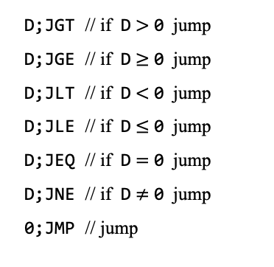
Labels
Typical branching instructions:
D;JGT // if D $>$ 0 jump
D;JGE // if D $≥$ 0 jump
D;JLT // if D $<$ 0 jump
D;JLE // if D $≤$ 0 jump
D;JEQ // if D $=$ 0 jump
D;JNE // if D $≠$ 0 jump
0;JMP // jump
to
ROM[A]
Examples (similar to what we did before):
// goto 48
// if (D > 0) goto 21
// if (RAM[100] < 0) goto 35
?
?
?

Slide 90
Labels
Typical branching instructions:
D;JGT // if D $>$ 0 jump
D;JGE // if D $≥$ 0 jump
D;JLT // if D $<$ 0 jump
D;JLE // if D $≤$ 0 jump
D;JEQ // if D $=$ 0 jump
D;JNE // if D $≠$ 0 jump
0;JMP // jump
to
ROM[A]
Examples (similar to what we did before):
// goto 48
@48
0;JMP
// if (D > 0) goto 21
@21
D;JGT
// if (RAM[100] < 0) goto 35
@100
D=M
@35
D;JLT
Same examples, using labels
// goto LOOP
// if (D > 0) goto CONT
// if (x < 0) goto NEG

Slide 91
Labels
Typical branching instructions:
D;JGT // if D $>$ 0 jump
D;JGE // if D $≥$ 0 jump
D;JLT // if D $<$ 0 jump
D;JLE // if D $≤$ 0 jump
D;JEQ // if D $=$ 0 jump
D;JNE // if D $≠$ 0 jump
0;JMP // jump
to
ROM[A]
Examples (similar to what we did before):
// goto 48
@48
0;JMP
// if (D > 0) goto 21
@21
D;JGT
// if (RAM[100] < 0) goto 35
@100
D=M
@35
D;JLT
Same examples, using labels
// goto LOOP
@LOOP
0;JMP
// if (D > 0) goto CONT
// if (x < 0) goto NEG

Slide 92
Labels
Typical branching instructions:
D;JGT // if D $>$ 0 jump
D;JGE // if D $≥$ 0 jump
D;JLT // if D $<$ 0 jump
D;JLE // if D $≤$ 0 jump
D;JEQ // if D $=$ 0 jump
D;JNE // if D $≠$ 0 jump
0;JMP // jump
to
ROM[A]
Examples (similar to what we did before):
// goto 48
@48
0;JMP
// if (D > 0) goto 21
@21
D;JGT
// if (RAM[100] < 0) goto 35
@100
D=M
@35
D;JLT
Same examples, using labels
// goto LOOP
@LOOP
0;JMP
// if (D > 0) goto CONT
@CONT
D;JGT
// if (x < 0) goto NEG

Slide 93
Labels
Typical branching instructions:
D;JGT // if D $>$ 0 jump
D;JGE // if D $≥$ 0 jump
D;JLT // if D $<$ 0 jump
D;JLE // if D $≤$ 0 jump
D;JEQ // if D $=$ 0 jump
D;JNE // if D $≠$ 0 jump
0;JMP // jump
to
ROM[A]
Examples (similar to what we did before):
// goto 48
@48
0;JMP
// if (D > 0) goto 21
@21
D;JGT
// if (RAM[100] < 0) goto 35
@100
D=M
@35
D;JLT
Same examples, using labels
// goto LOOP
@LOOP
0;JMP
// if (D > 0) goto CONT
@CONT
D;JGT
// if (x < 0) goto NEG
@x
D=M
@NEG
D;JLT
Hack convention:
Variables: lower-case symbols
Labels: upper-case symbols

Slide 94
Labels
Example (pseudocode)
Hack assembly
...
LOOP:
if (i = 0) goto CONT
do this
...
goto LOOP
CONT:
do that
...
write

Slide 95
Labels
Example (pseudocode)
Hack assembly
...
LOOP:
if (i = 0) goto CONT
do this
...
goto LOOP
CONT:
do that
...
...
(LOOP)
// if (i = 0) goto CONT
@i
D=M
@CONT
D;JEQ
do this
...
// goto LOOP
@LOOP
0;JMP
(CONT)
do that
...
Hack assembly syntax:
A label sym is declared using (sym)
Any label sym declared somewhere in the program can appear in a @sym instruction
The assembler resolves the labels to actual addresses.
write
Programs that use symbolic labels and variables are...
Easy to write / translate from pseudocode
Readable
Relocatable.

Slide 96
Chapter 4: Machine Language
Overview
Machine languages
The Hack computer
The Hack instruction set
The Hack CPU Emulator
Symbolic programming
Control
Variables
Labels
Low Level Programming
Basic
Iteration
Pointers
The Hack Language
Usage
Specification
Output
Input
Project 4

Slide 97
Program example 1: Add
Task: R2 ← R0 + R1 + 17
Add.asm
// Sets R2 to R0 + R1 + 17

Slide 98
Program example 1: Add
Task: R2 ← R0 + R1 + 17
Add.asm
// Sets R2 to R0 + R1 + 17
// D = R0
@R0
D=M
// D = D + R1
@R1
D=D+M
// D = D + 17
@17
D=D+A
// R2 = D
@R2
M=D

Slide 99
Program example 2: Signum
Pseudocode
// if R0 >= 0 then R1 = 1
// else R1 = –1

Slide 100
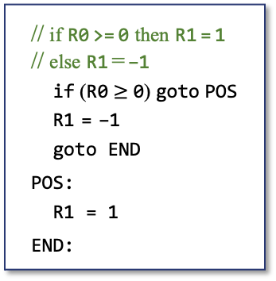
Program example 2: Signum
Pseudocode
Signum.asm
// if R0 >= 0 then R1 = 1
// else R1 = –1
if (R0 $≥$ 0) goto POS
R1 = –1
goto END
POS:
R1 = 1
END:
// if R0 >= 0 then R1 = 1
// else R1 = –1
write

Slide 101
Program example 2: Signum
Pseudocode
Signum.asm
// if R0 >= 0 then R1 = 1
// else R1 = –1
if (R0 $≥$ 0) goto POS
R1 = –1
goto END
POS:
R1 = 1
END:
// if R0 >= 0 then R1 = 1
// else R1 = –1
// if R0 >= 0 goto POS
@R0
D=M
@POS
D;JGE
// R1 = –1
@R1
M=–1
// goto END
@END
0;JMP
(POS)
// R1 = 1
@R1
M=1
(END)
write
Best practice
When writing a (non-trivial) assembly program, always start with writing pseudocode.
Then translate the pseudo instructions into assembly, line by line.

Slide 102
Program example 2: Signum
Pseudocode
Signum.asm
Memory
// if R0 >= 0 then R1 = 1
// else R1 = –1
if (R0 $≥$ 0) goto POS
R1 = –1
goto END
POS:
R1 = 1
END:
// if R0 >= 0 then R1 = 1
// else R1 = –1
// if R0 >= 0 goto POS
@R0
D=M
@POS
D;JGE
// R1 = –1
@R1
M=–1
// goto END
@END
0;JMP
(POS)
// R1 = 1
@R1
M=1
(END)
0
@0
1
D=M
2
@8
3
D;JGE
4
@1
Assembler / loader
5
M=–1
6
@10
7
0;JMP
8
@1
(Note how the assembler mapped all the symbols on physical addresses)
M=1
9
10
11
12
13
14
...

Slide 103
Watch out: Security breach
Pseudocode
Signum.asm
Memory
// if R0 >= 0 then R1 = 1
// else R1 = –1
if (R0 $≥$ 0) goto POS
R1 = –1
goto END
POS:
R1 = 1
END:
// if R0 >= 0 then R1 = 1
// else R1 = –1
// if R0 >= 0 goto POS
@R0
D=M
@POS
D;JGE
// R1 = –1
@R1
M=–1
// goto END
@END
0;JMP
(POS)
// R1 = 1
@R1
M=1
(END)
0
@0
1
D=M
2
@8
3
D;JGE
4
@1
Assembler / loader
5
M=–1
6
@10
7
0;JMP
8
@1
9
M=1
10
11
12
13
14
...

Slide 104
Watch out: Security breach
Pseudocode
Signum.asm
Memory
// if R0 >= 0 then R1 = 1
// else R1 = –1
if (R0 $≥$ 0) goto POS
R1 = –1
goto END
POS:
R1 = 1
END:
// if R0 >= 0 then R1 = 1
// else R1 = –1
// if R0 >= 0 goto POS
@R0
D=M
@POS
D;JGE
// R1 = –1
@R1
M=–1
// goto END
@END
0;JMP
(POS)
// R1 = 1
@R1
M=1
(END)
0
@0
1
D=M
2
@8
3
D;JGE
4
@1
Assembler / loader
5
M=–1
6
@10
7
0;JMP
8
@1
9
M=1
10
0111111000111110
11
1010101001011110
12
0100100110011011
13
1110010011111111
The memory is never empty
14
0101011100110111
...

Slide 105
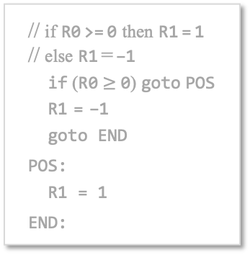
Watch out: Security breach
Pseudocode
Signum.asm
Memory
// if R0 >= 0 then R1 = 1
// else R1 = –1
if (R0 $≥$ 0) goto POS
R1 = –1
goto END
POS:
R1 = 1
END:
// if R0 >= 0 then R1 = 1
// else R1 = –1
// if R0 >= 0 goto POS
@R0
D=M
@POS
D;JGE
// R1 = –1
@R1
M=–1
// goto END
@END
0;JMP
(POS)
// R1 = 1
@R1
M=1
(END)
0
@0
1
D=M
2
@8
3
D;JGE
4
@1
5
M=–1
Program execution:
@10
6
7
0;JMP
8
@1
9
M=1
10
0111111000111110
11
1010101001011110
12
0100100110011011
13
1110010011111111
14
0101011100110111
...

Slide 106
Watch out: Security breach
Pseudocode
Signum.asm
Memory
// if R0 >= 0 then R1 = 1
// else R1 = –1
if (R0 $≥$ 0) goto POS
R1 = –1
goto END
POS:
R1 = 1
END:
// if R0 >= 0 then R1 = 1
// else R1 = –1
// if R0 >= 0 goto POS
@R0
D=M
@POS
D;JGE
// R1 = –1
@R1
M=–1
// goto END
@END
0;JMP
(POS)
// R1 = 1
@R1
M=1
(END)
0
@0
1
D=M
2
@8
3
D;JGE
4
@1
5
M=–1
Program execution:
@10
6
7
0;JMP
8
@1
9
M=1
10
0111111000111110
11
1010101001011110
12
Malicious
13
Code
14
0101011100110111
...

Slide 107
Watch out: Security breach
Pseudocode
Signum.asm
Memory
// if R0 >= 0 then R1 = 1
// else R1 = –1
if (R0 $≥$ 0) goto POS
R1 = –1
goto END
POS:
R1 = 1
END:
// if R0 >= 0 then R1 = 1
// else R1 = –1
// if R0 >= 0 goto POS
@R0
D=M
@POS
D;JGE
// R1 = –1
@R1
M=–1
// goto END
@END
0;JMP
(POS)
// R1 = 1
@R1
M=1
(END)
0
@0
1
D=M
2
@8
3
D;JGE
4
@1
5
M=–1
Program execution:
@10
6
7
0;JMP
8
@1
9
M=1
10
0111111000111110
11
1010101001011110
12
Malicious
13
Code
14
0101011100110111
...

Slide 108
Terminating programs properly
Pseudocode
Signum.asm
// if R0 >= 0 then R1 = 1
// else R1 = –1
if (R0 $≥$ 0) goto POS
R1 = –1
goto END
POS:
R1 = 1
END:
// if R0 >= 0 then R1 = 1
// else R1 = –1
// if R0 >= 0 goto POS
@R0
D=M
@POS
D;JGE
// R1 = –1
@R1
M=–1
// goto END
@END
0;JMP
(POS)
// R1 = 1
@R1
M=1
(END)

Slide 109
Terminating programs properly
Pseudocode
Signum.asm
// if R0 >= 0 then R1 = 1
// else R1 = –1
if (R0 $≥$ 0) goto POS
R1 = –1
goto END
POS:
R1 = 1
END:
// if R0 >= 0 then R1 = 1
// else R1 = –1
// if R0 >= 0 goto POS
@R0
D=M
@POS
D;JGE
// R1 = –1
@R1
M=–1
// goto END
@END
0;JMP
(POS)
// R1 = 1
@R1
M=1
(END)
@END
0;JMP
Infinite loop

Slide 110
Terminating programs properly
Pseudocode
Signum.asm
Memory
// if R0 >= 0 then R1 = 1
// else R1 = –1
if (R0 $≥$ 0) goto POS
R1 = –1
goto END
POS:
R1 = 1
END:
// if R0 >= 0 then R1 = 1
// else R1 = –1
// if R0 >= 0 goto POS
@R0
D=M
@POS
D;JGE
// R1 = –1
@R1
M=–1
// goto END
@END
0;JMP
(POS)
// R1 = 1
@R1
M=1
(END)
@END
0;JMP
0
@0
1
@D=M
2
@8
3
@D;JGE
4
@1
Assembler / loader
5
@M=-1
6
@10
7
@0;JMP
8
@1
9
@M=1
10
@10
11
0;JMP
Infinite loop
12
0100100110011011
13
1110010011111111
14
0101011100110111
...

Slide 111
Terminating programs properly
Pseudocode
Signum.asm
Memory
// if R0 >= 0 then R1 = 1
// else R1 = –1
if (R0 $≥$ 0) goto POS
R1 = –1
goto END
POS:
R1 = 1
END:
// if R0 >= 0 then R1 = 1
// else R1 = –1
// if R0 >= 0 goto POS
@R0
D=M
@POS
D;JGE
// R1 = –1
@R1
M=–1
// goto END
@END
0;JMP
(POS)
// R1 = 1
@R1
M=1
(END)
@END
0;JMP
0
@0
1
@D=M
2
@8
3
@D;JGE
4
@1
5
@M=–1
Program execution:
6
@10
7
@0;JMP
8
@1
9
@M=1
10
@10
11
0;JMP
12
0100100110011011
13
1110010011111111
14
0101011100110111
...

Slide 112
Terminating programs properly
Pseudocode
Signum.asm
Memory
// if R0 >= 0 then R1 = 1
// else R1 = –1
if (R0 $≥$ 0) goto POS
R1 = –1
goto END
POS:
R1 = 1
END:
// if R0 >= 0 then R1 = 1
// else R1 = –1
// if R0 >= 0 goto POS
@R0
D=M
@POS
D;JGE
// R1 = –1
@R1
M=–1
// goto END
@END
0;JMP
(POS)
// R1 = 1
@R1
M=1
(END)
@END
0;JMP
0
@0
1
@D=M
2
@8
3
@D;JGE
4
@1
5
@M=–1
Program execution:
6
@10
7
@0;JMP
8
@1
9
@M=1
10
@10
11
0;JMP
12
0100100110011011
13
1110010011111111
14
0101011100110111
...

Slide 113
Terminating programs properly
Pseudocode
Signum.asm
Memory
// if R0 >= 0 then R1 = 1
// else R1 = –1
if (R0 $≥$ 0) goto POS
R1 = –1
goto END
POS:
R1 = 1
END:
// if R0 >= 0 then R1 = 1
// else R1 = –1
// if R0 >= 0 goto POS
@R0
D=M
@POS
D;JGE
// R1 = –1
@R1
M=–1
// goto END
@END
0;JMP
(POS)
// R1 = 1
@R1
M=1
(END)
@END
0;JMP
0
@0
1
@D=M
2
@8
3
@D;JGE
4
@1
5
@M=–1
Program execution:
6
@10
7
@0;JMP
8
@1
9
@M=1
10
@10
11
0;JMP
12
0100100110011011
13
1110010011111111
14
0101011100110111
...

Slide 114
Terminating programs properly
Pseudocode
Signum.asm
Memory
// if R0 >= 0 then R1 = 1
// else R1 = –1
if (R0 $≥$ 0) goto POS
R1 = –1
goto END
POS:
R1 = 1
END:
// if R0 >= 0 then R1 = 1
// else R1 = –1
// if R0 >= 0 goto POS
@R0
D=M
@POS
D;JGE
// R1 = –1
@R1
M=–1
// goto END
@END
0;JMP
(POS)
// R1 = 1
@R1
M=1
(END)
@END
0;JMP
0
@0
1
@D=M
2
@8
3
@D;JGE
4
@1
5
@M=–1
Program execution:
6
@10
7
@0;JMP
8
@1
9
@M=1
10
@10
11
0;JMP
12
0100100110011011
13
1110010011111111
14
0101011100110111
...

Slide 115
Terminating programs properly
Pseudocode
Signum.asm
Memory
// if R0 >= 0 then R1 = 1
// else R1 = –1
if (R0 $≥$ 0) goto POS
R1 = –1
goto END
POS:
R1 = 1
END:
// if R0 >= 0 then R1 = 1
// else R1 = –1
// if R0 >= 0 goto POS
@R0
D=M
@POS
D;JGE
// R1 = –1
@R1
M=–1
// goto END
@END
0;JMP
(POS)
// R1 = 1
@R1
M=1
(END)
@END
0;JMP
0
@0
1
@D=M
2
@8
3
@D;JGE
4
@1
5
@M=–1
Program execution:
6
@10
7
@0;JMP
8
@1
9
@M=1
10
@10
11
0;JMP
12
0100100110011011
13
1110010011111111
14
0101011100110111
...

Slide 116
Terminating programs properly
Pseudocode
Signum.asm
Memory
// if R0 >= 0 then R1 = 1
// else R1 = –1
if (R0 $≥$ 0) goto POS
R1 = –1
goto END
POS:
R1 = 1
END:
// if R0 >= 0 then R1 = 1
// else R1 = –1
// if R0 >= 0 goto POS
@R0
D=M
@POS
D;JGE
// R1 = –1
@R1
M=–1
// goto END
@END
0;JMP
(POS)
// R1 = 1
@R1
M=1
(END)
@END
0;JMP
0
@0
1
@D=M
2
@8
3
@D;JGE
4
@1
5
@M=–1
Program execution:
6
@10
7
@0;JMP
8
@1
9
@M=1
10
@10
11
0;JMP
12
0100100110011011
13
1110010011111111
14
0101011100110111
...

Slide 117
Terminating programs properly
Pseudocode
Signum.asm
Memory
// if R0 >= 0 then R1 = 1
// else R1 = –1
if (R0 $≥$ 0) goto POS
R1 = –1
goto END
POS:
R1 = 1
END:
// if R0 >= 0 then R1 = 1
// else R1 = –1
// if R0 >= 0 goto POS
@R0
D=M
@POS
D;JGE
// R1 = –1
@R1
M=–1
// goto END
@END
0;JMP
(POS)
// R1 = 1
@R1
M=1
(END)
@END
0;JMP
0
@0
1
@D=M
2
@8
3
@D;JGE
4
@1
5
@M=–1
Program execution:
6
@10
7
@0;JMP
8
@1
9
@M=1
10
@10
11
0;JMP
12
0100100110011011
13
1110010011111111
14
0101011100110111
...

Slide 118
Terminating programs properly
Pseudocode
Signum.asm
Memory
// if R0 >= 0 then R1 = 1
// else R1 = –1
if (R0 $≥$ 0) goto POS
R1 = –1
goto END
POS:
R1 = 1
END:
// if R0 >= 0 then R1 = 1
// else R1 = –1
// if R0 >= 0 goto POS
@R0
D=M
@POS
D;JGE
// R1 = –1
@R1
M=–1
// goto END
@END
0;JMP
(POS)
// R1 = 1
@R1
M=1
(END)
@END
0;JMP
0
@0
1
@D=M
2
@8
3
@D;JGE
4
@1
5
@M=–1
6
@10
7
@0;JMP
8
@1
9
@M=1
10
@10
11
0;JMP
12
0100100110011011
13
1110010011111111
Best practice:
Terminate every assembly program with an infinite loop.
0101011100110111
14
...

Slide 119
Program example 3: Max
Task: Set R0 to max(R1, R2)
Examples: max(5,3) = 5, max(2,7) = 7, max(4,4) = 4
Pseudocode
// if (R1 > R2) then R0 = R1
// else R0 = R2
...

Slide 120
Program example 3: Max
Task: Set R0 to max(R1, R2)
Examples: max(5,3) = 5, max(2,7) = 7, max(4,4) = 4
Pseudocode
Max2.asm
// if (R1 > R2) then R0 = R1
// else R0 = R2
...
// You do it
write
Write the pseudocode
Translate and write the assembly code in a text file named Max2.asm
Load Max2.asm into the CPU emulator
Put some values in R1 and R2
Run the program, one instruction at a time
Make sure that the program puts the correct value in R0.

Slide 121
Chapter 4: Machine Language
Overview
Machine languages
The Hack computer
The Hack instruction set
The Hack CPU Emulator
Symbolic programming
Control
Variables
Labels
Low Level Programming
Basic
Iteration
Pointers
The Hack Language
Usage
Specification
Output
Input
Project 4

Slide 122
Iterative processing
Example: Compute 1 + 2 + 3 + ... + N
Pseudocode
// Program: Sum1ToN (R0 represents N)
// Computes R1 = 1 + 2 + 3 + ... + R0
// Usage: put a value >= 1 in R0

Slide 123
Iterative processing
Example: Compute 1 + 2 + 3 + ... + N
Pseudocode
// Program: Sum1ToN (R0 represents N)
// Computes R1 = 1 + 2 + 3 + ... + R0
// Usage: put a value >= 1 in R0
i = 1
sum = 0
LOOP:
if (i > R0) goto STOP
sum = sum + i
i = i + 1
goto LOOP
STOP:
R1 = sum

Slide 124
Iterative processing
Example: Compute 1 + 2 + 3 + ... + N
Pseudocode
Hack assembly
// Program: Sum1ToN (R0 represents N)
// Computes R1 = 1 + 2 + 3 + ... + R0
// Usage: put a value >= 1 in R0
i = 1
sum = 0
LOOP:
if (i > R0) goto STOP
sum = sum + i
i = i + 1
goto LOOP
STOP:
R1 = sum
// Program: Sum1ToN (R0 represents N)
// Computes R1 = 1 + 2 + 3 + ... + R0
// Usage: put a value >= 1 in R0

Slide 125
Iterative processing
Example: Compute 1 + 2 + 3 + ... + N
Pseudocode
Hack assembly
(code continues here)
// Program: Sum1ToN (R0 represents N)
// Computes R1 = 1 + 2 + 3 + ... + R0
// Usage: put a value >= 1 in R0
i = 1
sum = 0
LOOP:
if (i > R0) goto STOP
sum = sum + i
i = i + 1
goto LOOP
STOP:
R1 = sum
// Program: Sum1ToN (R0 represents N)
// Computes R1 = 1 + 2 + 3 + ... + R0
// Usage: put a value >= 1 in R0
// i = 1
@i
M=1
// sum = 0
@sum
M=0
(LOOP)
// if (i > R0) goto STOP
@i
D=M
@R0
D=D-M
@STOP
D;JGT
// sum = sum + i
@sum
D=M
@i
D=D+M
@sum
M=D
// i = i + 1
@i
M=M+1
// goto LOOP
@LOOP
0;JMP

Slide 126
Iterative processing
Example: Compute 1 + 2 + 3 + ... + N
Pseudocode
Hack assembly
(code continues here)
// Program: Sum1ToN (R0 represents N)
// Computes R1 = 1 + 2 + 3 + ... + R0
// Usage: put a value >= 1 in R0
i = 1
sum = 0
LOOP:
if (i > R0) goto STOP
sum = sum + i
i = i + 1
goto LOOP
STOP:
R1 = sum
// Program: Sum1ToN (R0 represents N)
// Computes R1 = 1 + 2 + 3 + ... + R0
// Usage: put a value >= 1 in R0
// i = 1
@i
M=1
// sum = 0
@sum
M=0
(LOOP)
// if (i > R0) goto STOP
@i
D=M
@R0
D=D-M
@STOP
D;JGT
// sum = sum + i
@sum
D=M
@i
D=D+M
@sum
M=D
// i = i + 1
@i
M=M+1
// goto LOOP
@LOOP
0;JMP
(STOP)
// R1 = sum
@sum
D=M
@R1
M=D
// infinite loop
(END)
@END
0;JMP

Slide 127
Chapter 4: Machine Language
Overview
Machine languages
The Hack computer
The Hack instruction set
The Hack CPU Emulator
Symbolic programming
Control
Variables
Labels
Low Level Programming
Basic
Iteration
Pointers
The Hack Language
Usage
Specification
Output
Input
Project 4

Slide 128
Pointer-based processing
Example 1: Set the register at address addr to –1
Input: R0: Holds addr
RAM
0
R0
1
R1
2
R2
// Sets RAM[R0] to –1
// Usage: Put some non-negative value in R0
...
...
15
16
17
...
255
256
...
1012
1013
1014
1015
1016
...

Slide 129
Pointer-based processing
Example 1: Set the register at address addr to –1
Input: R0: Holds addr
RAM
0
1013
R0
1
R1
2
R2
// Sets RAM[R0] to –1
// Usage: Put some non-negative value in R0
...
...
15
16
17
...
255
256
...
1012
desired result
1013
-1
1014
1015
1016
...

Slide 130
Pointer-based processing
Example 1: Set the register at address addr to –1
Input: R0: Holds addr
RAM
0
1013
R0
1
R1
2
R2
// Sets RAM[R0] to –1
// Usage: Put some non-negative value in R0
@R0
A=M
M=-1
...
...
15
16
17
The key instruction:
In the Hack machine language, pointer-based processing is realized by setting the address register to the address that we want to access, using the instruction A = …
...
255
256
...
1012
desired result
1013
-1
1014
1015
1016
...

Slide 131
Pointer-based processing
Example 1: Set the register at address addr to –1
Input: R0: Holds addr
RAM
0
R0
1
R1
2
R2
// Sets RAM[R0] to –1
// Usage: Put some non-negative value in R0
@R0
A=M
M=-1
...
...
15
16
17
...
255
256
...
1012
Example 2:
1013
// Sets RAM[R0] to R1
// Usage: Put some non-negative value in R0,
// and some value in R1.
1014
1015
1016
...

Slide 132
Pointer-based processing
Example 1: Set the register at address addr to –1
Input: R0: Holds addr
RAM
0
1015
R0
1
-17
R1
2
R2
// Sets RAM[R0] to –1
// Usage: Put some non-negative value in R0
@R0
A=M
M=-1
...
...
15
16
17
...
255
256
...
1012
Example 2:
1013
// Sets RAM[R0] to R1
// Usage: Put some non-negative value in R0,
// and some value in R1.
1014
desired result
1015
-17
1016
...
?

Slide 133
Pointer-based processing
Example 1: Set the register at address addr to –1
Input: R0: Holds addr
RAM
0
1015
R0
1
-17
R1
2
R2
// Sets RAM[R0] to –1
// Usage: Put some non-negative value in R0
@R0
A=M
M=-1
...
...
15
16
17
...
255
256
...
1012
Example 2:
1013
// Sets RAM[R0] to R1
// Usage: Put some non-negative value in R0,
// and some value in R1.
@R1
D=M
@R0
A=M
M=D
1014
desired result
1015
-17
1016
...

Slide 134
Pointer-based processing
Example 3: Get the value of the register at addr
Input: R0: Holds addr
RAM
0
R0
1
R1
2
R2
// Gets R1 = RAM[R0]
// Usage: Put some non-negative value in R0
...
...
15
16
17
...
255
256
...
1012
1013
1014
1015
1016
...

Slide 135
Pointer-based processing
Example 3: Get the value of the register at addr
Input: R0: Holds addr
RAM
0
1013
R0
desired result
1
75
R1
2
R2
// Gets R1 = RAM[R0]
// Usage: Put some non-negative value in R0
...
...
15
16
17
?
...
255
256
...
1012
512
1013
75
1014
19
1015
-17
1016
256
...

Slide 136
Pointer-based processing
Example 3: Get the value of the register at addr
Input: R0: Holds addr
RAM
0
1013
R0
desired result
1
75
R1
2
R2
// Gets R1 = RAM[R0]
// Usage: Put some non-negative value in R0
@R0
A=M
D=M
@R1
M=D
...
...
15
16
17
...
255
256
...
1012
512
1013
75
1014
19
1015
-17
1016
256
...

Slide 137
Pointer-based processing
Example 4: Set the first n entries of the memory block beginning in address base to –1
Inputs: R0: base R1: n
RAM
0
R0
1
R1
2
R2
...
...
15
R15
16
17
...
255
256
...
300
301
302
303
304
305
...

Slide 138
Pointer-based processing
Example 4: Set the first n entries of the memory block beginning in address base to –1
Inputs: R0: base R1: n
Example: base = 300, n = 5
RAM
0
300
R0
base
1
5
R1
n
2
R2
...
...
15
R15
16
17
...
255
// Program: PointerDemo.asm
// Starting at the address stored in R0,
// sets the first R1 words to –1
256
...
300
–1
301
–1
desired output
302
–1
303
–1
304
–1
305
...

Slide 139
Pointer-based processing
Example 4: Set the first n entries of the memory block beginning in address base to –1
Inputs: R0: base R1: n
Example: base = 300, n = 5
RAM
0
300
R0
base
1
5
R1
n
2
R2
...
...
15
R15
16
17
...
255
// Program: PointerDemo.asm
// Starting at the address stored in R0,
// sets the first R1 words to –1
256
...
300
301
302
303
304
305
...

Slide 140
Pointer-based processing
Example 4: Set the first n entries of the memory block beginning in address base to –1
Inputs: R0: base R1: n
Example: base = 300, n = 5
RAM
0
300
R0
base
1
5
R1
n
2
R2
...
...
15
R15
16
0
i
17
...
255
// Program: PointerDemo.asm
// Starting at the address stored in R0,
// sets the first R1 words to –1
256
...
300
301
302
303
304
305
...

Slide 141
Pointer-based processing
Example 4: Set the first n entries of the memory block beginning in address base to –1
Inputs: R0: base R1: n
Example: base = 300, n = 5
RAM
0
300
R0
base
1
5
R1
n
2
R2
...
...
15
R15
16
0
i
17
...
255
// Program: PointerDemo.asm
// Starting at the address stored in R0,
// sets the first R1 words to –1
256
...
300
–1
301
302
303
304
305
...

Slide 142
Pointer-based processing
Example 4: Set the first n entries of the memory block beginning in address base to –1
Inputs: R0: base R1: n
Example: base = 300, n = 5
RAM
0
300
R0
base
1
5
R1
n
2
R2
...
...
15
R15
16
1
i
17
...
255
// Program: PointerDemo.asm
// Starting at the address stored in R0,
// sets the first R1 words to –1
256
...
300
–1
301
302
303
304
305
...

Slide 143
Pointer-based processing
Example 4: Set the first n entries of the memory block beginning in address base to –1
Inputs: R0: base R1: n
Example: base = 300, n = 5
RAM
0
300
R0
base
1
5
R1
n
2
R2
...
...
15
R15
16
1
i
17
...
255
// Program: PointerDemo.asm
// Starting at the address stored in R0,
// sets the first R1 words to –1
256
...
300
–1
301
–1
302
303
304
305
...

Slide 144
Pointer-based processing
Example 4: Set the first n entries of the memory block beginning in address base to –1
Inputs: R0: base R1: n
Example: base = 300, n = 5
RAM
0
300
R0
base
1
5
R1
n
2
R2
...
...
15
R15
16
2
i
17
...
255
// Program: PointerDemo.asm
// Starting at the address stored in R0,
// sets the first R1 words to –1
256
...
300
–1
301
–1
302
303
304
305
...

Slide 145
Pointer-based processing
Example 4: Set the first n entries of the memory block beginning in address base to –1
Inputs: R0: base R1: n
Example: base = 300, n = 5
RAM
0
300
R0
base
1
5
R1
n
2
R2
...
...
15
R15
16
2
i
17
...
255
// Program: PointerDemo.asm
// Starting at the address stored in R0,
// sets the first R1 words to –1
256
...
300
–1
301
–1
302
–1
303
304
305
...

Slide 146
Pointer-based processing
Example 4: Set the first n entries of the memory block beginning in address base to –1
Inputs: R0: base R1: n
Example: base = 300, n = 5
RAM
0
300
R0
base
1
5
R1
n
2
R2
...
...
15
R15
16
3
i
17
...
255
// Program: PointerDemo.asm
// Starting at the address stored in R0,
// sets the first R1 words to –1
256
...
300
–1
301
–1
302
–1
303
304
305
...

Slide 147
Pointer-based processing
Example 4: Set the first n entries of the memory block beginning in address base to –1
Inputs: R0: base R1: n
Example: base = 300, n = 5
RAM
0
300
R0
base
1
5
R1
n
2
R2
...
...
15
R15
16
3
i
17
...
255
// Program: PointerDemo.asm
// Starting at the address stored in R0,
// sets the first R1 words to –1
256
...
300
–1
301
–1
302
–1
303
–1
304
305
...

Slide 148
Pointer-based processing
Example 4: Set the first n entries of the memory block beginning in address base to –1
Inputs: R0: base R1: n
Example: base = 300, n = 5
RAM
0
300
R0
base
1
5
R1
n
2
R2
...
...
15
R15
16
4
i
17
...
255
// Program: PointerDemo.asm
// Starting at the address stored in R0,
// sets the first R1 words to –1
256
...
300
–1
301
–1
302
–1
303
–1
304
305
...

Slide 149
Pointer-based processing
Example 4: Set the first n entries of the memory block beginning in address base to –1
Inputs: R0: base R1: n
Example: base = 300, n = 5
RAM
0
300
R0
base
1
5
R1
n
2
R2
...
...
15
R15
16
4
i
17
...
255
// Program: PointerDemo.asm
// Starting at the address stored in R0,
// sets the first R1 words to –1
256
...
300
–1
301
–1
302
–1
303
–1
304
–1
305
...

Slide 150
Pointer-based processing
Example 4: Set the first n entries of the memory block beginning in address base to –1
Inputs: R0: base R1: n
Example: base = 300, n = 5
RAM
0
300
R0
base
1
5
R1
n
2
R2
...
...
15
R15
16
5
i
17
...
255
// Program: PointerDemo.asm
// Starting at the address stored in R0,
// sets the first R1 words to –1
256
...
300
–1
301
–1
302
–1
303
–1
304
–1
305
...

Slide 151
Pointer-based processing
Example 4: Set the first n entries of the memory block beginning in address base to –1
Inputs: R0: base R1: n
Example: base = 300, n = 5
RAM
0
300
R0
base
1
5
R1
n
2
R2
...
...
15
R15
16
5
i
17
...
255
// Program: PointerDemo.asm
// Starting at the address stored in R0,
// sets the first R1 words to –1
256
...
300
–1
301
–1
desired output
302
–1
303
–1
304
–1
305
...

Slide 152
Pointer-based processing
Example 4: Set the first n entries of the memory block beginning in address base to –1
Inputs: R0: base R1: n
Example: base = 300, n = 5
RAM
0
300
R0
base
1
5
R1
n
2
R2
...
...
15
R15
16
5
i
17
...
255
// Program: PointerDemo.asm
// Starting at the address stored in R0,
// sets the first R1 words to –1
...
// RAM[R0 + i] = –1
256
...
300
–1
The key operation
301
–1
desired output
302
–1
303
–1
?
304
–1
305
...

Slide 153
Pointer-based processing
Example 4: Set the first n entries of the memory block beginning in address base to –1
Inputs: R0: base R1: n
Example: base = 300, n = 5
RAM
0
300
R0
base
1
5
R1
n
2
R2
...
...
15
R15
16
5
i
17
...
255
// Program: PointerDemo.asm
// Starting at the address stored in R0,
// sets the first R1 words to –1
...
// RAM[R0 + i] = –1
@R0
D=M
@i
A=D+M
M=-1
...
256
...
300
–1
The key operation
301
–1
desired output
302
–1
303
–1
304
–1
305
...

Slide 154
Pointer-based processing
Pseudocode
RAM
// Program: PointerDemo.asm
// Starting at the address stored in R0,
// sets the first R1 words to –1
0
300
R0
1
5
R1
2
R2
...
...
15
R15
16
i
17
...
255
256
...
300
–1
301
–1
desired output
302
–1
303
–1
304
–1
305
...

Slide 155
Pointer-based processing
Pseudocode
RAM
// Program: PointerDemo.asm
// Starting at the address stored in R0,
// sets the first R1 words to –1
i = 0
LOOP:
if (i == R1) goto END
RAM[R0 + i] = -1
i = i + 1
goto LOOP
END:
0
300
R0
1
5
R1
2
R2
...
...
15
R15
16
i
17
...
255
256
...
300
–1
301
–1
desired output
302
–1
303
–1
304
–1
305
...

Slide 156
Pointer-based processing
Pseudocode
Assembly code
RAM
// Program: PointerDemo.asm
// Starting at the address stored in R0,
// sets the first R1 words to –1
i = 0
LOOP:
if (i == R1) goto END
RAM[R0 + i] = -1
i = i + 1
goto LOOP
END:
// Program: PointerDemo.asm
// Starting at the address stored in R0,
// sets the first R1 words to –1
0
300
R0
1
5
R1
2
R2
?
...
...
15
R15
16
i
17
...
255
256
...
300
-1
301
-1
desired output
302
-1
303
-1
304
-1
305
...

Slide 157
Pointer-based processing
Pseudocode
Assembly code
RAM
// Program: PointerDemo.asm
// Starting at the address stored in R0,
// sets the first R1 words to –1
i = 0
LOOP:
if (i == R1) goto END
RAM[R0 + i] = -1
i = i + 1
goto LOOP
END:
// Program: PointerDemo.asm
// Starting at the address stored in R0,
// sets the first R1 words to –1
// i = 0
@i
M=0
(LOOP)
// if (i == R1) goto END
@i
D=M
@R1
D=D-M
@END
D;JEQ
// RAM[R0 + i] = -1
@R0
D=M
@i
A=D+M
M=-1
// i = i + 1
@i
M=M+1
// goto LOOP
@LOOP
0;JMP
(END)
@END
0;JMP
0
300
R0
1
5
R1
2
R2
...
...
15
R15
16
i
17
...
255
256
...
300
–1
301
–1
desired output
302
–1
303
–1
304
–1
305
...

Slide 158
Array processing
Pseudocode
Assembly code
RAM
// Program: PointerDemo.asm
// Starting at the address stored in R0,
// sets the first R1 words to –1
i = 0
LOOP:
if (i == R1) goto END
RAM[R0 + i] = -1
i = i + 1
goto LOOP
END:
// Program: PointerDemo.asm
// Starting at the address stored in R0,
// sets the first R1 words to –1
// i = 0
@i
M=0
(LOOP)
// if (i == R1) goto END
@i
D=M
@R1
D=D-M
@END
D;JEQ
// RAM[R0 + i] = -1
@R0
D=M
@i
A=D+M
M=-1
// i = i + 1
@i
M=M+1
// goto LOOP
@LOOP
0;JMP
(END)
@END
0;JMP
0
300
R0
1
5
R1
2
R2
...
...
15
R15
16
i
17
...
255
256
...
300
–1
301
–1
desired output
302
–1
Array processing
Is done similarly, using pointer-based access to the memory block that represents the array.
303
–1
304
–1
305
...

Slide 159
Array processing
High-level code (e.g. Java)
RAM
...
// Declares variables
int[] arr = new int[5];
int sum = 0;
...
// Enters some values into the array
// (code omitted)
...
// Sums up the array elements
for (int j = 0; j < 5; j++) {
sum = sum + arr[j];
}
...
0
R0
1
R1
2
R2
...
...
15
R15
16
17
...
75
76
...
255
256
...
5034
5035
5036
5037
5038
5036
...

Slide 160
Array processing
High-level code (e.g. Java)
RAM
...
// Declares variables
int[] arr = new int[5];
int sum = 0;
...
// Enters some values into the array
// (code omitted)
...
// Sums up the array elements
for (int j = 0; j < 5; j++) {
sum = sum + arr[j];
}
...
0
R0
1
R1
2
R2
...
...
15
R15
16
5034
arr
Memory state after executing this code:
17
357
sum
...
4
j
75
76
...
255
256
...
5034
100
5035
50
5036
200
5037
2
5038
5
5036
...

Slide 161
Array processing
High-level code (e.g. Java)
Hack assembly
RAM
...
// Declares variables
int[] arr = new int[5];
int sum = 0;
...
// Enters some values into the array
// (code omitted)
...
// Sums up the array elements
for (int j = 0; j < 5; j++) {
sum = sum + arr[j];
}
...
...
0
R0
1
R1
2
R2
...
...
15
R15
16
5034
arr
17
357
sum
...
4
j
Compiler
75
76
...
255
256
...
5034
100
5035
50
5036
200
5037
2
5038
5
5036
...

Slide 162
Array processing
High-level code (e.g. Java)
Hack assembly
RAM
...
// Declares variables
int[] arr = new int[5];
int sum = 0;
...
// Enters some values into the array
// (code omitted)
...
// Sums up the array elements
for (int j = 0; j < 5; j++) {
sum = sum + arr[j];
}
...
...
// sum = sum + arr[j]
@arr
D=M
@j
A=D+M
D=M
@sum
M=M+D
...
0
R0
1
R1
2
R2
...
...
15
R15
16
5034
arr
17
357
sum
...
4
j
Compiler
75
76
...
255
256
...
5034
100
5035
50
5036
200
5037
2
5038
5
5036
...

Slide 163
Array processing
High-level code (e.g. Java)
Hack assembly
RAM
...
// Declares variables
int[] arr = new int[5];
int sum = 0;
...
// Enters some values into the array
// (code omitted)
...
// Sums up the array elements
for (int j = 0; j < 5; j++) {
sum = sum + arr[j];
}
...
// Increments each array element
for (int j = 0; j < 5; j++) {
arr[j] = arr[j] + 1
}
...
...
// sum = sum + arr[j]
@arr
D=M
@j
A=D+M
D=M
@sum
M=M+D
...
0
R0
1
R1
2
R2
...
...
15
R15
16
5034
arr
17
357
sum
...
4
j
Compiler
75
76
...
255
256
...
5034
100
5035
50
5036
200
5037
2
5038
5
5036
...

Slide 164
Array processing
High-level code (e.g. Java)
Hack assembly
RAM
...
// Declares variables
int[] arr = new int[5];
int sum = 0;
...
// Enters some values into the array
// (code omitted)
...
// Sums up the array elements
for (int j = 0; j < 5; j++) {
sum = sum + arr[j];
}
...
// Increments each array element
for (int j = 0; j < 5; j++) {
arr[j] = arr[j] + 1
}
...
...
// sum = sum + arr[j]
@arr
D=M
@j
A=D+M
D=M
@sum
M=M+D
...
// arr[j] = arr[j] + 1
0
R0
1
R1
2
R2
...
...
15
R15
16
5034
arr
17
357
sum
...
4
j
Compiler
75
76
...
255
?
256
...
5034
100
5035
50
5036
200
5037
2
5038
5
5036
...

Slide 165
Array processing
High-level code (e.g. Java)
Hack assembly
RAM
...
// Declares variables
int[] arr = new int[5];
int sum = 0;
...
// Enters some values into the array
// (code omitted)
...
// Sums up the array elements
for (int j = 0; j < 5; j++) {
sum = sum + arr[j];
}
...
// Increments each array element
for (int j = 0; j < 5; j++) {
arr[j] = arr[j] + 1
}
...
...
// sum = sum + arr[j]
@arr
D=M
@j
A=D+M
D=M
@sum
M=M+D
...
// arr[j] = arr[j] + 1
@arr
D=M
@j
A=D+M
M=M+1
...
0
R0
1
R1
2
R2
...
...
15
R15
16
5034
arr
17
357
sum
...
4
j
Compiler
75
76
...
255
256
...
5034
100
5035
50
5036
200
5037
2
5038
5
5036
...
Every high-level array access operation involving arr[expression] can be compiled into Hack code that realizes the operation using the low-level memory access instruction A = arr + expression

Slide 166
Chapter 4: Machine Language
Overview
Machine languages
The Hack computer
The Hack instruction set
The Hack CPU Emulator
Symbolic programming
Control
Variables
Labels
Low Level Programming
Basic
Iteration
Pointers
The Hack Language
Usage
Specification
Output
Input
Project 4

Slide 167
The A instruction
Instruction set
A instruction
C instruction
Syntax:
Where value is either:
a constant, or
a symbol bound to a constant
@value
Semantics:
Sets the A register to the constant
Side effects:
RAM[A] becomes the selected RAM register
ROM[A] becomes the selected ROM register

Slide 168
The C instruction
Instruction set
A instruction
C instruction

Slide 169
The C instruction
Syntax:
dest = comp ; jump
both dest and jump are optional

Slide 170
The C instruction
Syntax:
dest = comp ; jump
both dest and jump are optional
where:
comp =
0, 1, –1, D, A, !D, !A, –D, –A, D+1, A+1, D–1, A–1, D+A, D–A, A–D, D&A, D|A
M, !M, –M, M+1, M–1, D+M, D–M, M–D, D&M, D|M
dest =
null, M, D, DM, A, AM, AD, ADM
M stands for RAM[A]
jump =
null, JGT, JEQ, JGE, JLT, JNE, JLE, JMP
Semantics:
Computes the value of comp and stores the result in dest.
If (comp jump 0), jumps to execute ROM[A]

Slide 171
The C instruction
Syntax:
dest = comp ; jump
both dest and jump are optional
where:
comp =
0, 1, –1, D, A, !D, !A, –D, –A, D+1, A+1, D–1, A–1, D+A, D–A, A–D, D&A, D|A
M, !M, –M, M+1, M–1, D+M, D–M, M–D, D&M, D|M
dest =
null, M, D, DM, A, AM, AD, ADM
M stands for RAM[A]
jump =
null, JGT, JEQ, JGE, JLT, JNE, JLE, JMP
Semantics:
Computes the value of comp and stores the result in dest.
If (comp jump 0), jumps to execute ROM[A]
Examples:
// Sets the D register to -1

Slide 172
The C instruction
Syntax:
dest = comp ; jump
both dest and jump are optional
where:
comp =
0, 1, –1, D, A, !D, !A, –D, –A, D+1, A+1, D–1, A–1, D+A, D–A, A–D, D&A, D|A
M, !M, –M, M+1, M–1, D+M, D–M, M–D, D&M, D|M
dest =
null, M, D, DM, A, AM, AD, ADM
M stands for RAM[A]
jump =
null, JGT, JEQ, JGE, JLT, JNE, JLE, JMP
Semantics:
Computes the value of comp and stores the result in dest.
If (comp jump 0), jumps to execute ROM[A]
Examples:
// Sets the D register to -1
D=-1

Slide 173
The C instruction
Syntax:
dest = comp ; jump
both dest and jump are optional
where:
comp =
0, 1, –1, D, A, !D, !A, –D, –A, D+1, A+1, D–1, A–1, D+A, D–A, A–D, D&A, D|A
M, !M, –M, M+1, M–1, D+M, D–M, M–D, D&M, D|M
dest =
null, M, D, DM, A, AM, AD, ADM
M stands for RAM[A]
jump =
null, JGT, JEQ, JGE, JLT, JNE, JLE, JMP
Semantics:
Computes the value of comp and stores the result in dest.
If (comp jump 0), jumps to execute ROM[A]
Examples:
// Sets D and M to the value of the D register, plus 1

Slide 174
The C instruction
Syntax:
dest = comp ; jump
both dest and jump are optional
where:
comp =
0, 1, –1, D, A, !D, !A, –D, –A, D+1, A+1, D–1, A–1, D+A, D–A, A–D, D&A, D|A
M, !M, –M, M+1, M–1, D+M, D–M, M–D, D&M, D|M
dest =
null, M, D, DM, A, AM, AD, ADM
M stands for RAM[A]
jump =
null, JGT, JEQ, JGE, JLT, JNE, JLE, JMP
Semantics:
Computes the value of comp and stores the result in dest.
If (comp jump 0), jumps to execute ROM[A]
Examples:
// Sets D and M to the value of the D register, plus 1
DM=D+1

Slide 175
The C instruction
Syntax:
dest = comp ; jump
both dest and jump are optional
where:
comp =
0, 1, –1, D, A, !D, !A, –D, –A, D+1, A+1, D–1, A–1, D+A, D–A, A–D, D&A, D|A
M, !M, –M, M+1, M–1, D+M, D–M, M–D, D&M, D|M
dest =
null, M, D, DM, A, AM, AD, ADM
M stands for RAM[A]
jump =
null, JGT, JEQ, JGE, JLT, JNE, JLE, JMP
Semantics:
Computes the value of comp and stores the result in dest.
If (comp jump 0), jumps to execute ROM[A]
Examples:
// If (D-1 = 0) jumps to execute the instruction stored in ROM[56]

Slide 176
The C instruction
Syntax:
dest = comp ; jump
both dest and jump are optional
where:
comp =
0, 1, –1, D, A, !D, !A, –D, –A, D+1, A+1, D–1, A–1, D+A, D–A, A–D, D&A, D|A
M, !M, –M, M+1, M–1, D+M, D–M, M–D, D&M, D|M
dest =
null, M, D, DM, A, AM, AD, ADM
M stands for RAM[A]
jump =
null, JGT, JEQ, JGE, JLT, JNE, JLE, JMP
Semantics:
Computes the value of comp and stores the result in dest.
If (comp jump 0), jumps to execute ROM[A]
Examples:
// If (D-1 = 0) jumps to execute the instruction stored in ROM[56]
@56
D-1;JEQ

Slide 177
Recap: A instructions and C instructions
They normally come in pairs:
// RAM[5] = RAM[5] - 1
@5
M=M-1
To set up for a C instruction that mentions M,
Use an A instruction that selects the memory address on which you want to operate
// if D=0 goto 100
@100
D;JEQ
To set up for a C instruction that specifies a jump,
Use an A instruction that selects the memory address to which you want to jump
Observation: C instructions that include both M and a jump directive make no sense
Best practice rule: Each C instruction should …
Either have a reference to M
Or have a jump directive
But not both.

Slide 178
Chapter 4: Machine Language
Overview
Machine languages
The Hack computer
The Hack instruction set
The Hack CPU Emulator
Symbolic programming
Control
Variables
Labels
Low Level Programming
Basic
Iteration
Pointers
The Hack Language
Usage
Specification
Output
Input
Project 4

Slide 179
The Hack machine language
So far, we illustrated the Hack language using examples.
We now turn to give a complete language specification.

Slide 180
Hack machine language
ROM
RAM
data out
CPU
instructions
Binary code
data in
The Hack language:
Symbolic: (example)
Binary:
...
@17
D;JLE
...
translate
...
0000000000010001
1110001100000110
...
load & execute
The binary version of the language is not essential for low-level programming
We present it anyway, for completeness
The binary version will come to play when we’ll build the computer architecture (chapter 5) and the assembler (chapter 6)

Slide 181
A instruction
Action: Sets the A register to a constant
Symbolic syntax:
Binary syntax:
@value
0vvvvvvvvvvvvvvvv
Where value is either:
a non-negative decimal constant ≤ 32767 ( = 2¹⁵ – 1)
or a symbol bound to a constant
Where:
0 is the A instruction op-code
v v v … v is the 15-bit binary representation of the constant
Example:
Symbolic:
Binary:
@6
0000000000000110

Slide 182
C instruction
comp is mandatory.
If dest is empty, the = is omitted; If jump is empty, the ; is omitted
Symbolic syntax:
dest = comp ; jump
15 14 13 12 11 10 9 8 7 6 5 4 3 2 1 0
Binary syntax:
1 1 1 a c c c c c c d d d j j j

Slide 183
C instruction
comp is mandatory.
If dest is empty, the = is omitted; If jump is empty, the ; is omitted
Symbolic syntax:
dest = comp ; jump
15 14 13 12 11 10 9 8 7 6 5 4 3 2 1 0
Binary syntax:
1 1 1 a c c c c c c d d d j j j
C instruction op-code
dest bits
jump bits
not used
comp bits

Slide 184
C instruction
comp is mandatory.
If dest is empty, the = is omitted; If jump is empty, the ; is omitted
Symbolic syntax:
dest = comp ; jump
15 14 13 12 11 10 9 8 7 6 5 4 3 2 1 0
Binary syntax:
1 1 1 a c c c c c c d d d j j j
comp bits
comp |  | c | c | c | c | c | c
0 |  | 1 | 0 | 1 | 0 | 1 | 0
1 |  | 1 | 1 | 1 | 1 | 1 | 1
–1 |  | 1 | 1 | 1 | 0 | 1 | 0
D |  | 0 | 0 | 1 | 1 | 0 | 0
A | M | 1 | 1 | 0 | 0 | 0 | 0
!D |  | 0 | 0 | 1 | 1 | 0 | 1
!A | !M | 1 | 1 | 0 | 0 | 0 | 1
–D |  | 0 | 0 | 1 | 1 | 1 | 1
–A | –M | 1 | 1 | 0 | 0 | 1 | 1
D+1 |  | 0 | 1 | 1 | 1 | 1 | 1
A+1 | M+1 | 1 | 1 | 0 | 1 | 1 | 1
D–1 |  | 0 | 0 | 1 | 1 | 1 | 0
A–1 | M–1 | 1 | 1 | 0 | 0 | 1 | 0
D+A | D+M | 0 | 0 | 0 | 0 | 1 | 0
D–A | D–M | 0 | 1 | 0 | 0 | 1 | 1
A–D | M–D | 0 | 0 | 0 | 1 | 1 | 1
D&A | D&M | 0 | 0 | 0 | 0 | 0 | 0
D|A | D|M | 0 | 1 | 0 | 1 | 0 | 1
a==0 | a==1

Slide 185
C instruction
comp is mandatory.
If dest is empty, the = is omitted; If jump is empty, the ; is omitted
Symbolic syntax:
dest = comp ; jump
15 14 13 12 11 10 9 8 7 6 5 4 3 2 1 0
Binary syntax:
1 1 1 a c c c c c c d d d j j j
dest bits
dest | d | d | d | effect: the value is stored in:
null | 0 | 0 | 0 | the value is not stored
M | 0 | 0 | 1 | RAM[A]
D | 0 | 1 | 0 | D register
DM | 0 | 1 | 1 | D register and RAM[A]
A | 1 | 0 | 0 | A register
AM | 1 | 0 | 1 | A register and RAM[A]
AD | 1 | 1 | 0 | A register and D register
ADM | 1 | 1 | 1 | A register, D register, and RAM[A]

Slide 186
C instruction
comp is mandatory.
If dest is empty, the = is omitted; If jump is empty, the ; is omitted
Symbolic syntax:
dest = comp ; jump
15 14 13 12 11 10 9 8 7 6 5 4 3 2 1 0
Binary syntax:
1 1 1 a c c c c c c d d d j j j
jump | j | j | j | effect:
null | 0 | 0 | 0 | no jump
JGT | 0 | 0 | 1 | if comp > 0 jump
JEQ | 0 | 1 | 0 | if comp = 0 jump
JGE | 0 | 1 | 1 | if comp ≥ 0 jump
JLT | 1 | 0 | 0 | if comp < 0 jump
JNE | 1 | 0 | 1 | if comp ≠ 0 jump
JLE | 1 | 1 | 0 | if comp ≤ 0 jump
JMP | 1 | 1 | 1 | Unconditional jump
jump bits

Slide 187
The Hack language specification
Symbolic:
@xxx
(xxx is a decimal value ranging from 0 to 32767, or a symbol bound to such a decimal value)
A instruction
Binary:
0 vvvvvvvvvvvvvvv
(vv ... v = 15-bit value of xxx)
Symbolic:
dest = comp; jump
(comp is mandatory. If dest is empty, the = is omitted; If jump is empty, the ; is omitted)
C instruction
Binary:
111accccccdddjjj
comp c c c c c c
dest d d d Effect: store comp in:
0 |  | 1 | 0 | 1 | 0 | 1 | 0
1 |  | 1 | 1 | 1 | 1 | 1 | 1
–1 |  | 1 | 1 | 1 | 0 | 1 | 0
D |  | 0 | 0 | 1 | 1 | 0 | 0
A | M | 1 | 1 | 0 | 0 | 0 | 0
!D |  | 0 | 0 | 1 | 1 | 0 | 1
!A | !M | 1 | 1 | 0 | 0 | 0 | 1
–D |  | 0 | 0 | 1 | 1 | 1 | 1
–A | -M | 1 | 1 | 0 | 0 | 1 | 1
D+1 |  | 0 | 1 | 1 | 1 | 1 | 1
A+1 | M+1 | 1 | 1 | 0 | 1 | 1 | 1
D–1 |  | 0 | 0 | 1 | 1 | 1 | 0
A–1 | M–1 | 1 | 1 | 0 | 0 | 1 | 0
D+A | D+M | 0 | 0 | 0 | 0 | 1 | 0
D–A | D–M | 0 | 1 | 0 | 0 | 1 | 1
A–D | M–D | 0 | 0 | 0 | 1 | 1 | 1
D&A | D&M | 0 | 0 | 0 | 0 | 0 | 0
D|A | D|M | 0 | 1 | 0 | 1 | 0 | 1
null | 0 | 0 | 0 | the value is not stored
M | 0 | 0 | 1 | RAM[A]
D | 0 | 1 | 0 | D register (reg)
DM | 0 | 1 | 1 | RAM[A] and D reg
A | 1 | 0 | 0 | A reg
AM | 1 | 0 | 1 | A reg and RAM[A]
AD | 1 | 1 | 0 | A reg and D reg
ADM | 1 | 1 | 1 | A reg, D reg, and RAM[A]
jump j j j Effect:
null | 0 | 0 | 0 | no jump
JGT | 0 | 0 | 1 | if comp > 0 jump
JEQ | 0 | 1 | 0 | if comp = 0 jump
JGE | 0 | 1 | 1 | if comp ≥ 0 jump
JLT | 1 | 0 | 0 | if comp < 0 jump
JNE | 1 | 0 | 1 | if comp ≠ 0 jump
JLE | 1 | 1 | 0 | if comp ≤ 0 jump
JMP | 1 | 1 | 1 | unconditional jump
a == 0 a == 1

Slide 188
The Hack language specification
Symbolic:
@xxx
(xxx is a decimal value ranging from 0 to 32767, or a symbol bound to such a decimal value)
A instruction
Binary:
0 vvvvvvvvvvvvvvv
(vv ... v = 15-bit value of xxx)
Symbolic:
dest = comp; jump
(comp is mandatory. If dest is empty, the = is omitted; If jump is empty, the ; is omitted)
C instruction
Binary:
111accccccdddjjj
comp c c c c c c
dest d d d Effect: store comp in:
0 |  | 1 | 0 | 1 | 0 | 1 | 0
1 |  | 1 | 1 | 1 | 1 | 1 | 1
–1 |  | 1 | 1 | 1 | 0 | 1 | 0
D |  | 0 | 0 | 1 | 1 | 0 | 0
A | M | 1 | 1 | 0 | 0 | 0 | 0
!D |  | 0 | 0 | 1 | 1 | 0 | 1
!A | !M | 1 | 1 | 0 | 0 | 0 | 1
–D |  | 0 | 0 | 1 | 1 | 1 | 1
–A | -M | 1 | 1 | 0 | 0 | 1 | 1
D+1 |  | 0 | 1 | 1 | 1 | 1 | 1
A+1 | M+1 | 1 | 1 | 0 | 1 | 1 | 1
D–1 |  | 0 | 0 | 1 | 1 | 1 | 0
A–1 | M–1 | 1 | 1 | 0 | 0 | 1 | 0
D+A | D+M | 0 | 0 | 0 | 0 | 1 | 0
D–A | D–M | 0 | 1 | 0 | 0 | 1 | 1
A–D | M–D | 0 | 0 | 0 | 1 | 1 | 1
D&A | D&M | 0 | 0 | 0 | 0 | 0 | 0
D|A | D|M | 0 | 1 | 0 | 1 | 0 | 1
null | 0 | 0 | 0 | the value is not stored
M | 0 | 0 | 1 | RAM[A]
D | 0 | 1 | 0 | D register (reg)
DM | 0 | 1 | 1 | RAM[A] and D reg
A | 1 | 0 | 0 | A reg
AM | 1 | 0 | 1 | A reg and RAM[A]
AD | 1 | 1 | 0 | A reg and D reg
ADM | 1 | 1 | 1 | A reg, D reg, and RAM[A]
Predefined symbols:
symbol | value
R0 | 0
R1 | 1
R2 | 2
... | ...
R15 | 15
SP | 0
LCL | 1
ARG | 2
THIS | 3
THAT | 4
SCREEN | 16384
KBD | 24576
jump j j j Effect:
null | 0 | 0 | 0 | no jump
JGT | 0 | 0 | 1 | if comp > 0 jump
JEQ | 0 | 1 | 0 | if comp = 0 jump
JGE | 0 | 1 | 1 | if comp ≥ 0 jump
JLT | 1 | 0 | 0 | if comp < 0 jump
JNE | 1 | 0 | 1 | if comp ≠ 0 jump
JLE | 1 | 1 | 0 | if comp ≤ 0 jump
JMP | 1 | 1 | 1 | unconditional jump
a == 0 a == 1

Slide 189
Chapter 4: Machine Language
Overview
Machine languages
The Hack computer
The Hack instruction set
The Hack CPU Emulator
Symbolic programming
Control
Variables
Labels
Low Level Programming
Basic
Iteration
Pointers
The Hack Language
Usage
Specification
Output
Input
Project 4

Slide 190


Input / output
Screen: used to display outputs
ROM
RAM
instruc-
tions
data
Hello, world
CPU
Keyboard: used to enter inputs
High-level I/O handling:
Software libraries for inputting / outputting text, graphics, audio, video, …
Low-level I/O handling:
Manipulating bits in memory resident bitmaps.
Notes:
Input: loading selected RAM registers with values
Output: inspecting the state of selected RAM registers

Slide 191
Bitmaps
RAM
0
...
15
16
...
255
256
...
2047
2048
Hello, world
...
16383
16384
...
24575
24576
...
32767

Slide 192
Bitmaps
RAM
0
...
15
16
...
255
256
...
2047
2048
Hello, world
...
16383
16384
screen memory map
...
24575
24576
keyboard
...
32767

Slide 193
Bitmaps
RAM
0
...
15
16
...
255
256
...
2047
2048
Hello, world
...
SCREEN =
16383
16384
screen memory map
...
24575
24576
...
Screen memory map:
An 8K memory block, dedicated to representing a black-and-white display unit
Base address: SCREEN = 16384 (predefined symbol)
Output is effected by writing bits in the screen memory map.
32767

Slide 194
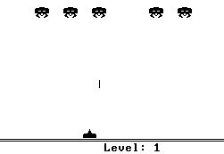
Bitmaps
Physical screen
...
...
...
...
...
Screen shots of computer games developed on the Hack computer

Slide 195
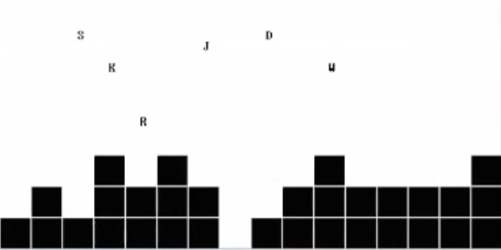
Bitmaps
Physical screen
...
...
...
...
...
Screen shots of computer games developed on the Hack computer

Slide 196
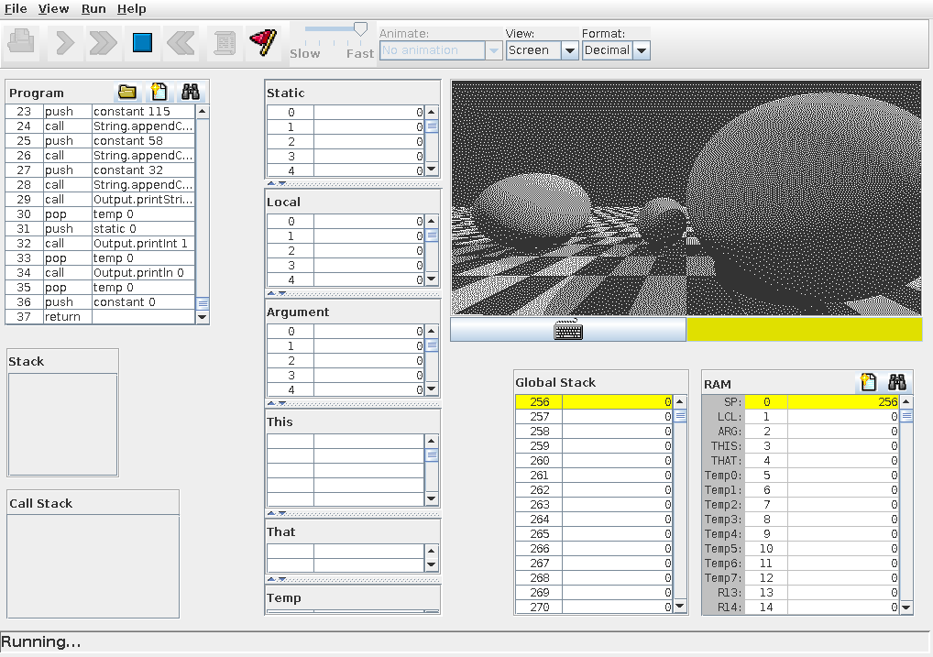
Bitmaps
Physical screen
...
...
...
...
...
Screen shots of computer games developed on the Hack computer

Slide 197
Bitmaps
Physical screen
0
1
2
3
4
5
6
7
8
...
511
0
...
1
...
...
...
255
...

Slide 198
Bitmaps
Screen Memory Map
Physical screen
16384
0
1111010100000000
0
1
2
3
4
5
6
7
8
...
511
=
1
0000000000000000
row 0
0
...
SCREEN
base address of the screen memory map
. . .
1
...
31
0000000000000001
...
...
32
0000101000000000
refresh
33
0000000000000000
row 1
. . .
63
0000000000000000
. . .
. . .
8159
1011010100000000
255
...
8160
0000000000000000
row 255
. . .
8191
0000000000000000
Mapping:
The pixel in location (row, col) in the physical screen is represented by the (col % 16)th bit in RAM address SCREEN + 32*row + col/16

Slide 199
Bitmaps
Screen Memory Map
Physical screen
16384
0
1111010100000000
0
1
2
3
4
5
6
7
8
...
511
=
1
0000000000000000
row 0
0
...
SCREEN
base address of the screen memory map
. . .
1
...
31
0000000000000001
...
...
32
0000101000000000
refresh
33
0000000000000000
row 1
. . .
63
0000000000000000
. . .
. . .
8159
1011010100000000
255
...
8160
0000000000000000
row 255
. . .
8191
0000000000000000
To set pixel (row , col) to black or white:
addr ← SCREEN + 32*row + col/16
word ← RAM[addr]
(2) Set the (col % 16)th bit of word to 0 or 1
RAM[addr] ← word
Not to worry:
Nice workarounds coming up
(Bitmap Editor)

Slide 200
Bitmaps
Screen Memory Map
Physical screen
16384
0
1111010100000000
0
1
2
3
4
5
6
7
8
...
511
=
1
0000000000000000
row 0
0
...
SCREEN
base address of the screen memory map
. . .
1
...
31
0000000000000001
...
...
32
0000101000000000
refresh
33
0000000000000000
row 1
. . .
63
0000000000000000
. . .
. . .
8159
1011010100000000
255
...
8160
0000000000000000
row 255
. . .
8191
0000000000000000
Examples of simple patterns that can be drawn relatively easily:
// Sets the first (left) 16 pixels
// of the top row to black

Slide 201
Bitmaps
Screen Memory Map
Physical screen
16384
0
1111010100000000
0
1
2
3
4
5
6
7
8
...
511
=
1
0000000000000000
row 0
0
...
SCREEN
base address of the screen memory map
. . .
1
...
31
0000000000000001
...
...
32
0000101000000000
refresh
33
0000000000000000
row 1
. . .
63
0000000000000000
. . .
. . .
8159
1011010100000000
255
...
8160
0000000000000000
row 255
. . .
8191
0000000000000000
Examples of simple patterns that can be drawn relatively easily:
// Sets the first 16 pixels
// of row 2 to black
// Sets the first (left) 16 pixels
// of the top row to black
@SCREEN
M=-1 // –1 = 1111111111111111
?

Slide 202
Bitmaps
Screen Memory Map
Physical screen
16384
0
1111010100000000
0
1
2
3
4
5
6
7
8
...
511
=
1
0000000000000000
row 0
0
...
SCREEN
base address of the screen memory map
. . .
1
...
31
0000000000000001
...
...
32
0000101000000000
refresh
33
0000000000000000
row 1
. . .
63
0000000000000000
. . .
. . .
8159
1011010100000000
255
...
8160
0000000000000000
row 255
. . .
8191
0000000000000000
Examples of simple patterns that can be drawn relatively easily:
// Sets the first 16 pixels
// of row 2 to black
@64
D=A
@SCREEN
A=A+D
M=-1
// Sets the entire screen
// to black / white
// Sets the first (left) 16 pixels
// of the top row to black
@SCREEN
M=-1 // –1 = 1111111111111111
(Project 4)

Slide 203
Bitmaps
Screen Memory Map
Physical screen
16384
0
1111010100000000
0
1
2
3
4
5
6
7
8
...
511
=
1
0000000000000000
row 0
0
...
SCREEN
base address of the screen memory map
. . .
1
...
31
0000000000000001
...
...
32
0000101000000000
refresh
33
0000000000000000
row 1
. . .
63
0000000000000000
. . .
. . .
8159
1011010100000000
255
...
8160
0000000000000000
row 255
. . .
8191
0000000000000000
Examples of simple patterns that can be drawn relatively easily:
Rectangle
Drawing
// Sets the first (left) 16 pixels
// of the top row to black
@SCREEN
M=-1 // –1 = 1111111111111111
Simple graphics program:
demo

Slide 204
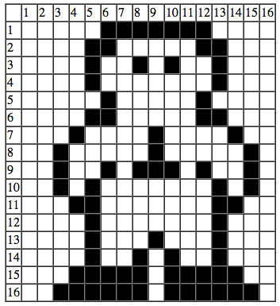
Bitmap Editor
0000111111100000 = 4064
0001100000110000 = 6192
0001001010010000 = 4752
...
...
0111111011111100 = 32508
Bitmap editor: A productivity tool for developers.
The developer draws a pixled image on a 2D grid, and the program generates code that draws the image in the RAM.
The generated code can be copy-pasted into the developer’s assembly code.
The Nand to Tetris Bitmap Editor is available in this Git project
Note: The editor generates either Jack code or Hack assembly code – see the radio buttons at the very bottom of the editor’s GUI.

Slide 205
Chapter 4: Machine Language
Overview
Machine languages
The Hack computer
The Hack instruction set
The Hack CPU Emulator
Symbolic programming
Control
Variables
Labels
Low Level Programming
Basic
Iteration
Pointers
The Hack Language
Usage
Specification
Output
Input
Project 4

Slide 206
Input
ROM
RAM
instruc-
tions
data
CPU
Keyboard: used to enter inputs
High-level input handling
readInt, readString, ...
Low-level input handling
Read bits.

Slide 207
Hack RAM
RAM
0
...
15
16
...
255
256
...
2047
2048
Hello, world
...
16383
16384
screen
...
24575
24576
keyboard
...
32767

Slide 208
Hack RAM
RAM
0
...
15
16
...
255
256
...
2047
2048
...
16383
16384
...
kbd =
24575
24576
keyboard
...
32767
Keyboard memory map
A single 16-bit register, dedicated to representing the keyboard
Base address: KBD = 24576 (predefined symbol)
Reading inputs is affected by probing this register.

Slide 209
The Hack character set
key | code
(space) | 32
! | 33
“ | 34
# | 35
$ | 36
% | 37
& | 38
‘ | 39
( | 40
) | 41
* | 42
+ | 43
, | 44
- | 45
. | 46
/ | 47
key | code
0 | 48
1 | 49
… | …
9 | 57
key | code
A | 65
B | 66
C | …
… | …
Z | 90
key | code
a | 97
b | 98
c | 99
… | …
z | 122
key | code
newline | 128
backspace | 129
left arrow | 130
up arrow | 131
right arrow | 132
down arrow | 133
home | 134
end | 135
Page up | 136
Page down | 137
insert | 138
delete | 139
esc | 140
f1 | 141
. . . | . . .
f12 | 152
: | 58
; | 59
< | 60
= | 61
> | 62
? | 63
@ | 64
[ | 91
/ | 92
] | 93
^ | 94
_ | 95
` | 96
{ | 123
| | 124
} | 125
~ | 126
(Subset of Unicode)

Slide 210
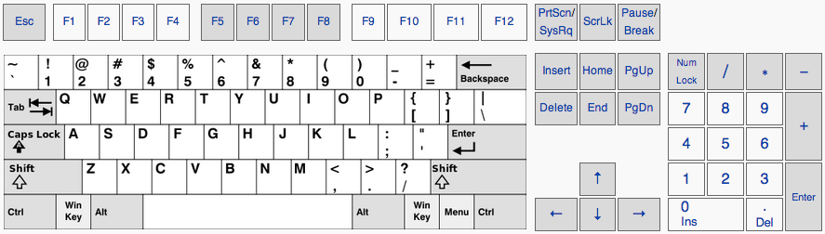
Memory mapped input
RAM
24576
0000000000000000
=
KBD
base address of the keyboard memory map

Slide 211
Memory mapped input
RAM
0000000000000000
k
24576
0000000001001011
=
KBD
base address of the keyboard memory map
code('k') = 75
When a key is pressed on the keyboard, the key’s character code appears in the keyboard memory map.

Slide 212
Memory mapped input
RAM
4
0000000000110100
24576
0000000000000000
=
KBD
base address of the keyboard memory map
code('4') = 52
When a key is pressed on the keyboard, the key’s character code appears in the keyboard memory map.

Slide 213
Memory mapped input
RAM
0000000010000011
24576
0000000000000000
=
⬆
KBD
base address of the keyboard memory map
code('⬆') = 131
When a key is pressed on the keyboard, the key’s character code appears in the keyboard memory map.

Slide 214
Memory mapped input
RAM
0000000000100000
24576
0000000000000000
=
KBD
space
base address of the keyboard memory map
code(' ') = 32
When a key is pressed on the keyboard, the key’s character code appears in the keyboard memory map.

Slide 215
Memory mapped input
RAM
24576
0000000000000000
=
KBD
base address of the keyboard memory map
When no key is pressed, the resulting code is 0.

Slide 216
Reading inputs
RAM
0000000000000000
k
24576
0000000001001011
=
KBD
base address of the keyboard memory map
code('k') = 75
Examples:
// Set D to the character code of
// the currently pressed key

Slide 217
Reading inputs
RAM
0000000000000000
k
24576
0000000001001011
=
KBD
base address of the keyboard memory map
code('k') = 75
Examples:
// Set D to the character code of
// the currently pressed key
@KBD
D=M
// If the currently pressed key is 'q', goto END

Slide 218
Reading inputs
RAM
0000000000000000
k
24576
0000000001001011
=
KBD
base address of the keyboard memory map
code('k') = 75
Examples:
// Set D to the character code of
// the currently pressed key
@KBD
D=M
// If the currently pressed key is 'q', goto END
@KBD
D=M
@113 // 'q'
D=D-A
@END
D;JEQ

Slide 219
Chapter 4: Machine Language
Overview
Machine languages
The Hack computer
The Hack instruction set
The Hack CPU Emulator
Symbolic programming
Control
Variables
Labels
Low Level Programming
Basic
Iteration
Pointers
The Hack Language
Usage
Specification
Output
Input
Project 4

Slide 220
Project 4
Objectives
Gain a hands-on taste of:
Low-level programming
Assembly language
The Hack computer
Tasks
Write a simple algebraic program: Mult
Write a simple interactive program: Fill
Be creative: Define and write some program of your own.

Slide 221
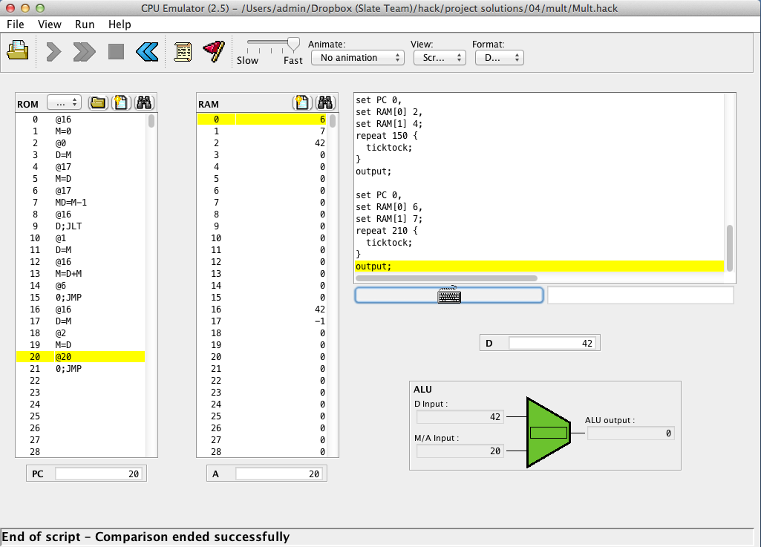
Mult: a program that computes R2 = R0 * R1
code not shown

Slide 222
Mult: a program that computes R2 = R0 * R1
code not shown

Slide 223
Mult: a program that computes R2 = R0 * R1
Implementation strategy
Loop: Repetitive addition
Inefficient implementation of multiplication, but OK for the purpose of this project.
code not shown

Slide 224
Fill: a simple interactive program
code not shown
code not shown
When the user presses a keyboard key (any key), the entire screen becomes black

Slide 225
Fill: a simple interactive program
code not shown
code not shown
The screen remains black as long as the key is pressed.

Slide 226
Fill: a simple interactive program
code not shown
code not shown
When the user releases the key, the screen is cleared

Slide 227
Fill: a simple interactive program
code not shown
code not shown

Slide 228
Fill: a simple interactive program
code not shown
code not shown
Etc...

Slide 229
Fill: a simple interactive program
code not shown
code not shown
Etc...

Slide 230
Fill: a simple interactive program
Implementation strategy
Execute an infinite loop that listens to the keyboard input
When a key is pressed (any key), execute code that writes "black" in every pixel
When no key is pressed, execute code that writes "white" in every pixel
​Tip: This program requires working with pointers.

Slide 231
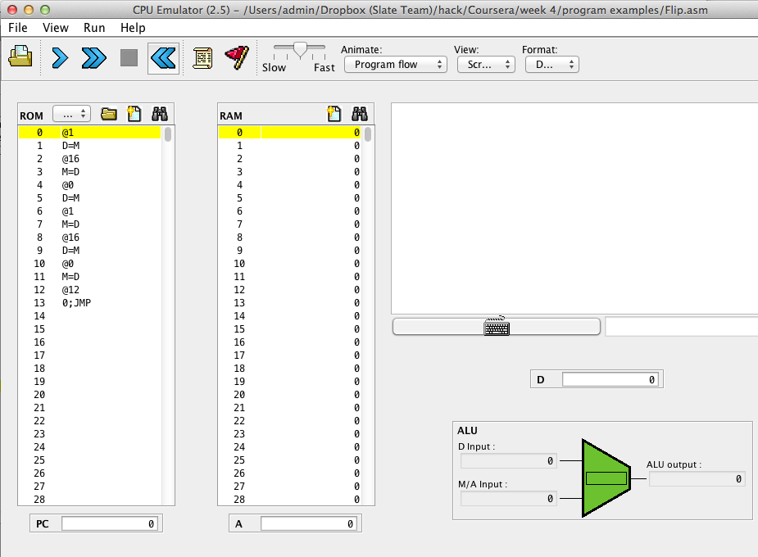

Program development process
Prog.asm
Write / edit the program using a text editor
Translation options
1. Let the CPU emulator translate into binary code (as seen on the left)
2. Use the supplied assembler:
Find it on your PC in nand2tetris/tools
See the Assembler Tutorial in Project 6 (www.nand2tetris.org)
Load the program into the CPU emulator, and run it
Find and fix the errors
happy with results?
Yes
No

Slide 232
Implementation notes
Well-written low-level code is
Compact
Efficient
Elegant
Self-describing
Tips
Use symbolic variables and labels
Use sensible variable and label names
Variables: lower-case
Labels: upper-case
Use indentation
Start by writing pseudocode.

Slide 233
Task 3:Define and write a program of your own
Any ideas?
It’s your call!

Slide 234
Nand to Tetris Roadmap (Part I: Hardware)
abstraction
This lecture:
The Hack computer / instruction set
Low-level programming
Assembly / assemblers
p4
Writing low-level programs
machine language
Developing an assembler
hardware platform
abstraction
Building a computer
computer
abstraction
Building chips
ALU, RAM
abstraction
Building gates
p2
elementary logic gates
Nand
p3
p1

Slide 235
Nand to Tetris Roadmap (Part I: Hardware)
abstraction
This lecture:
The Hack computer / instruction set
Low-level programming
Assembly / assemblers
p4
Writing low-level programs
machine language
Developing an assembler
hardware platform
abstraction
Building a computer
computer
abstraction
Building chips
p5
ALU, RAM
abstraction
Building gates
p2
elementary logic gates
Nand
p3
p1
Next lecture

